Slide 1
Hyperparameter Tuning with Bayesian Optimization
Samuel Wilson – 09/25/2019

Slide 2
What is a Hyperparameter?
Some aspect of a model that controls:
The model Structure
How the model is trained
Examples Include:
GLM | Random Forest | Neural Network
Lasso:Ridge Ratio | Minimum Samples per Split | Hidden Layers
Regularization Coefficient | Maximum Tree Depth | Nodes per Layer
 | Trees in Forest | Dropout
 |  | Weight Decay
 |  | …This list goes on forever

Slide 3

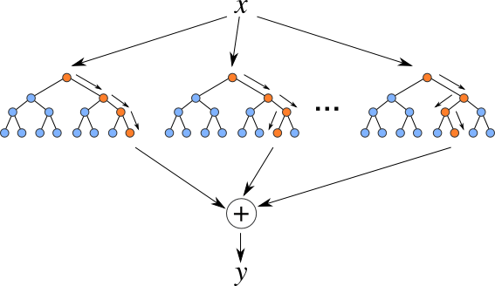

Slide 4
We can easily create a random forest to fit this data, but we need to be careful about which hyperparameters we use…

Slide 5
Random Forest
1 tree
500 max depth
100% row sampling
Holdout RMSE:
10
Trees | Depth | Subsample | OOB RMSE
1 | 500 | 100 | 10

Slide 6
Random Forest
10 trees
100 max depth
75% row sampling
Holdout RMSE:
5
Trees | Depth | Subsample | OOB RMSE
1 | 500 | 100 | 10
10 | 100 | 75 | 5

Slide 7
Random Forest
5000 trees
2 max depth
1% row sampling
Holdout RMSE:
7.5
Trees | Depth | Subsample | OOB RMSE
1 | 500 | 100 | 10
10 | 100 | 75 | 5
5000 | 2 | 1 | 7.5

Slide 8
Random Forest
? trees
? max depth
? row sampling
Holdout RMSE:
?
Trees | Depth | Subsample | OOB RMSE
1 | 500 | 100 | 10
10 | 100 | 75 | 5
5000 | 2 | 1 | 7.5

Slide 9
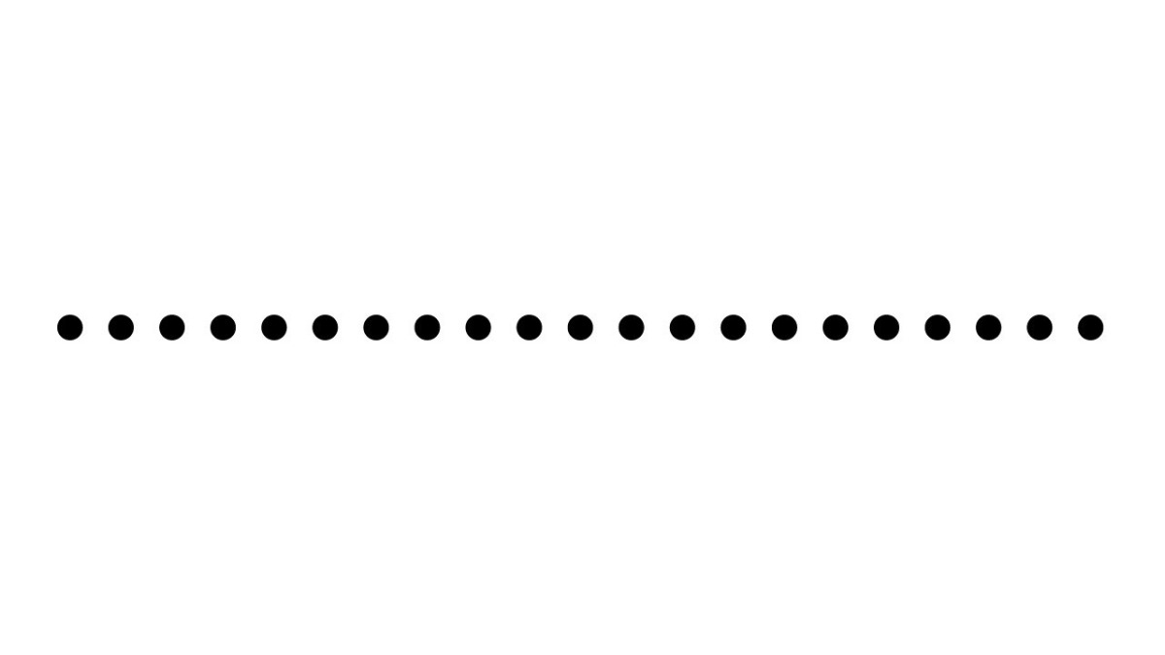
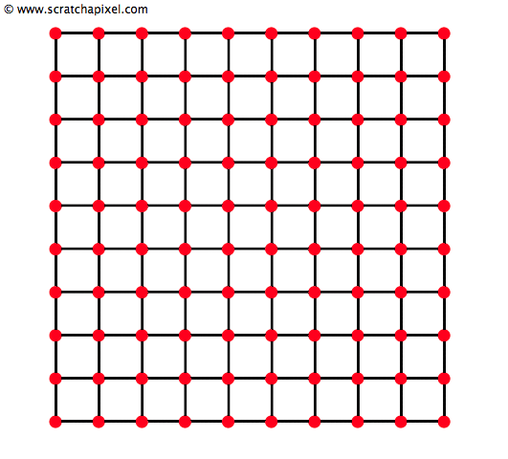
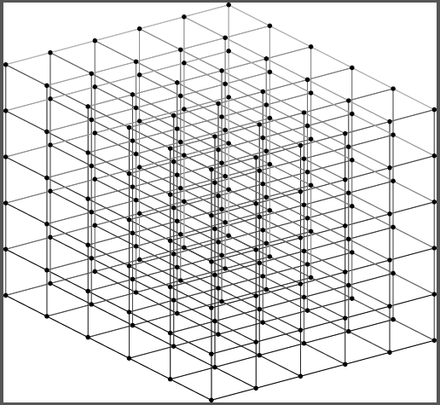

Option 1 – Grid Search
We run a model for a comprehensive set of parameters. This might give us a good parameter set, however running models can be expensive, so searching over the entire parameter space becomes intractable for models with many hyperparameters.
1 Parameter
2 Parameters
3 Parameters
4 Parameters

Slide 10
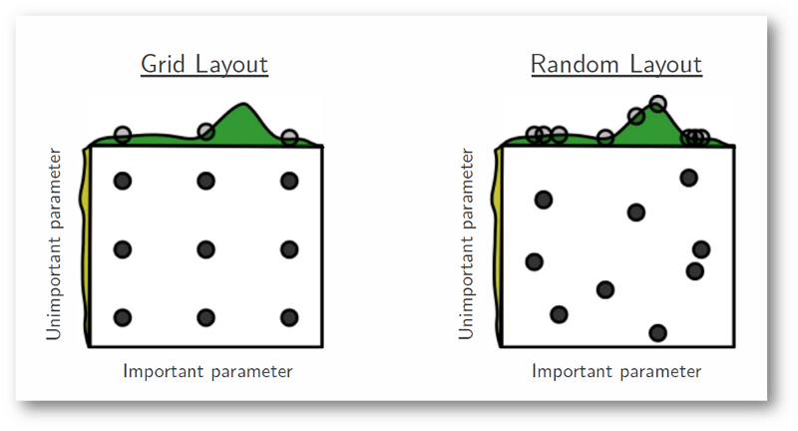
Option 2 – Random Search
We randomly choose parameters to run the model on. This has advantages over a grid search, however we are still flying blind.

Slide 11
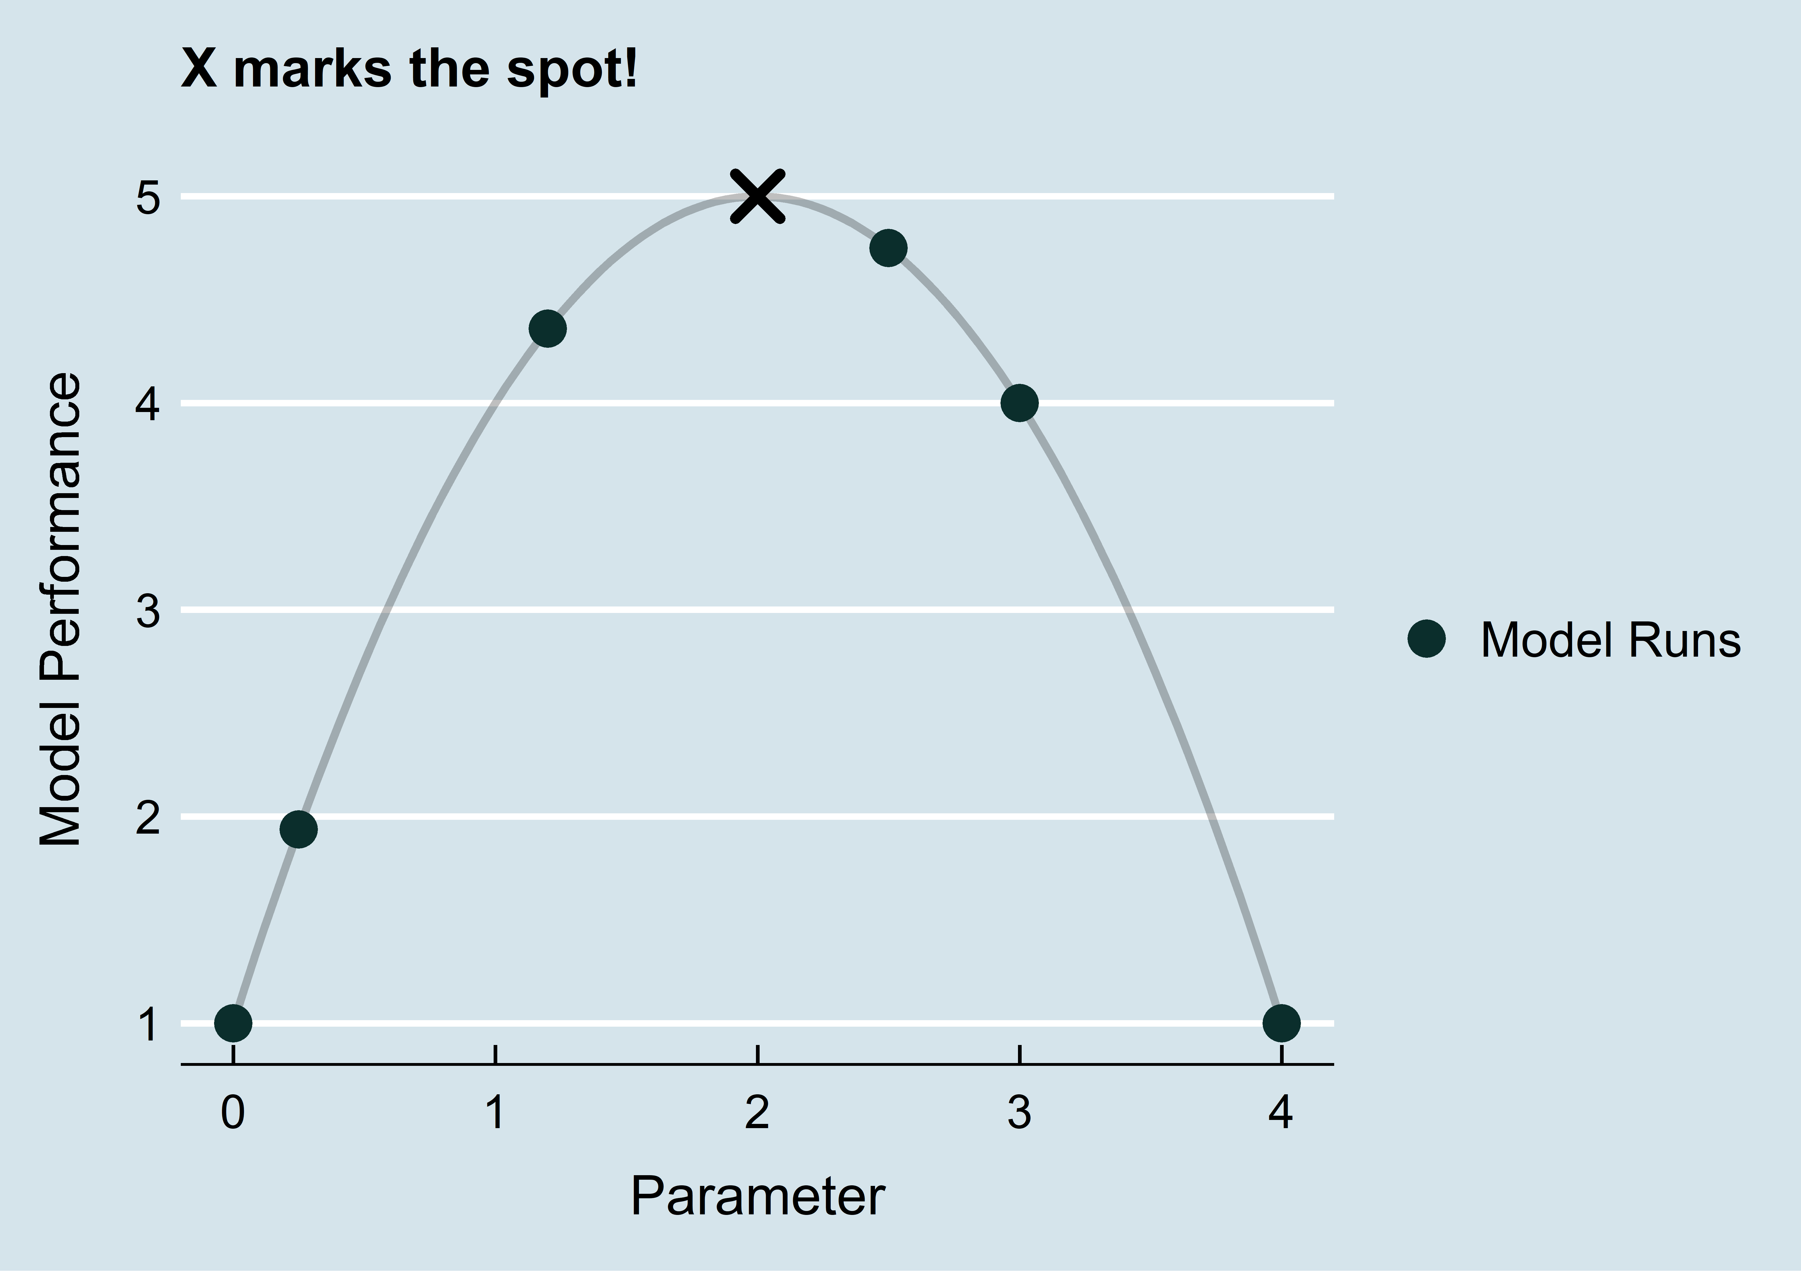
Option 3 – Run models at promising points
Preferably, we would have some type of process to tell us where to look next. Where have prior models performed well, and where do we still need to explore?

Slide 12
Random Forest
? trees
? max depth
? row sampling
Holdout RMSE:
?
Trees | Depth | Subsample | OOB RMSE
1 | 500 | 100 | 10
10 | 100 | 75 | 5
5000 | 2 | 1 | 7.5
We can use this information to tell us where to look next!

Slide 13
Let’s pretend for a second we know the real function.
To know this, we would have to run a model for every single possible parameter value.
This is intractable! Models can take days to run.

Slide 14
Let’s pretend for a second we know the real function.
To know this, we would have to run a model for every single possible parameter value.
This is intractable! Models can take days to run
If we knew this, we would just run the model with 1070 trees and be happy with our optimal model.

Slide 15
Let’s get a sample. We run the model 5 times and get the following results.
We just spent days getting these results.

Slide 16
This tells a different story.. One would be easily tricked into thinking the global minimum is around 2-3K trees.
This is easy for a human to optimize… in 1 dimension.
We still need to formally define how much potential each point has to figure out where to search next.

Slide 17
We now have an idea of where to look next!
We will talk about the construction of a Gaussian Process later.
The Gaussian Process has given us a formal definition of how we can assume Holdout RMSE is distributed for each value of Trees in Forest.

Slide 18
A Gaussian Process only defines our assumption about the distribution of our model performance metric
Different Acquisition Functions can be used to determine which point(s) should be sampled next.
Expected Improvement
Given that we did see an improvement over the current best, what is the expected improvement?
Lower Confidence Bound
What is the p% lower bound? Higher p can be chosen to incentivize exploration of “unknown” ranges
Probability of Improvement
What is the probability that we see an improvement at this point?

Slide 19
Run another model and update the Gaussian Process. Notice how the Utility functions have changed.
Expected Improvement
Upper Confidence Bound
Probability of Improvement

Slide 20
Run another model and update the Gaussian Process. Notice how the Utility functions have changed.
Expected Improvement
Given that we did see an improvement over the current best, what is the expected improvement?
Upper Confidence Bound
What is the p% upper bound? Higher p can be chose to incentivize exploration of “unknown” ranges
Probability of Improvement
What is the probability that we see an improvement at this point?

Slide 21
Run another model and update the Gaussian Process. Notice how the Utility functions have changed.
Expected Improvement
Given that we did see an improvement over the current best, what is the expected improvement?
Upper Confidence Bound
What is the p% upper bound? Higher p can be chose to incentivize exploration of “unknown” ranges
Probability of Improvement
What is the probability that we see an improvement at this point?

Slide 22
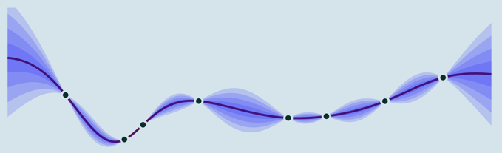
Gaussian Process
So far, the Gaussian process has been abstracted.
Definition: a collection of random variables, any finite number of which have Gaussian distributions.

Slide 23
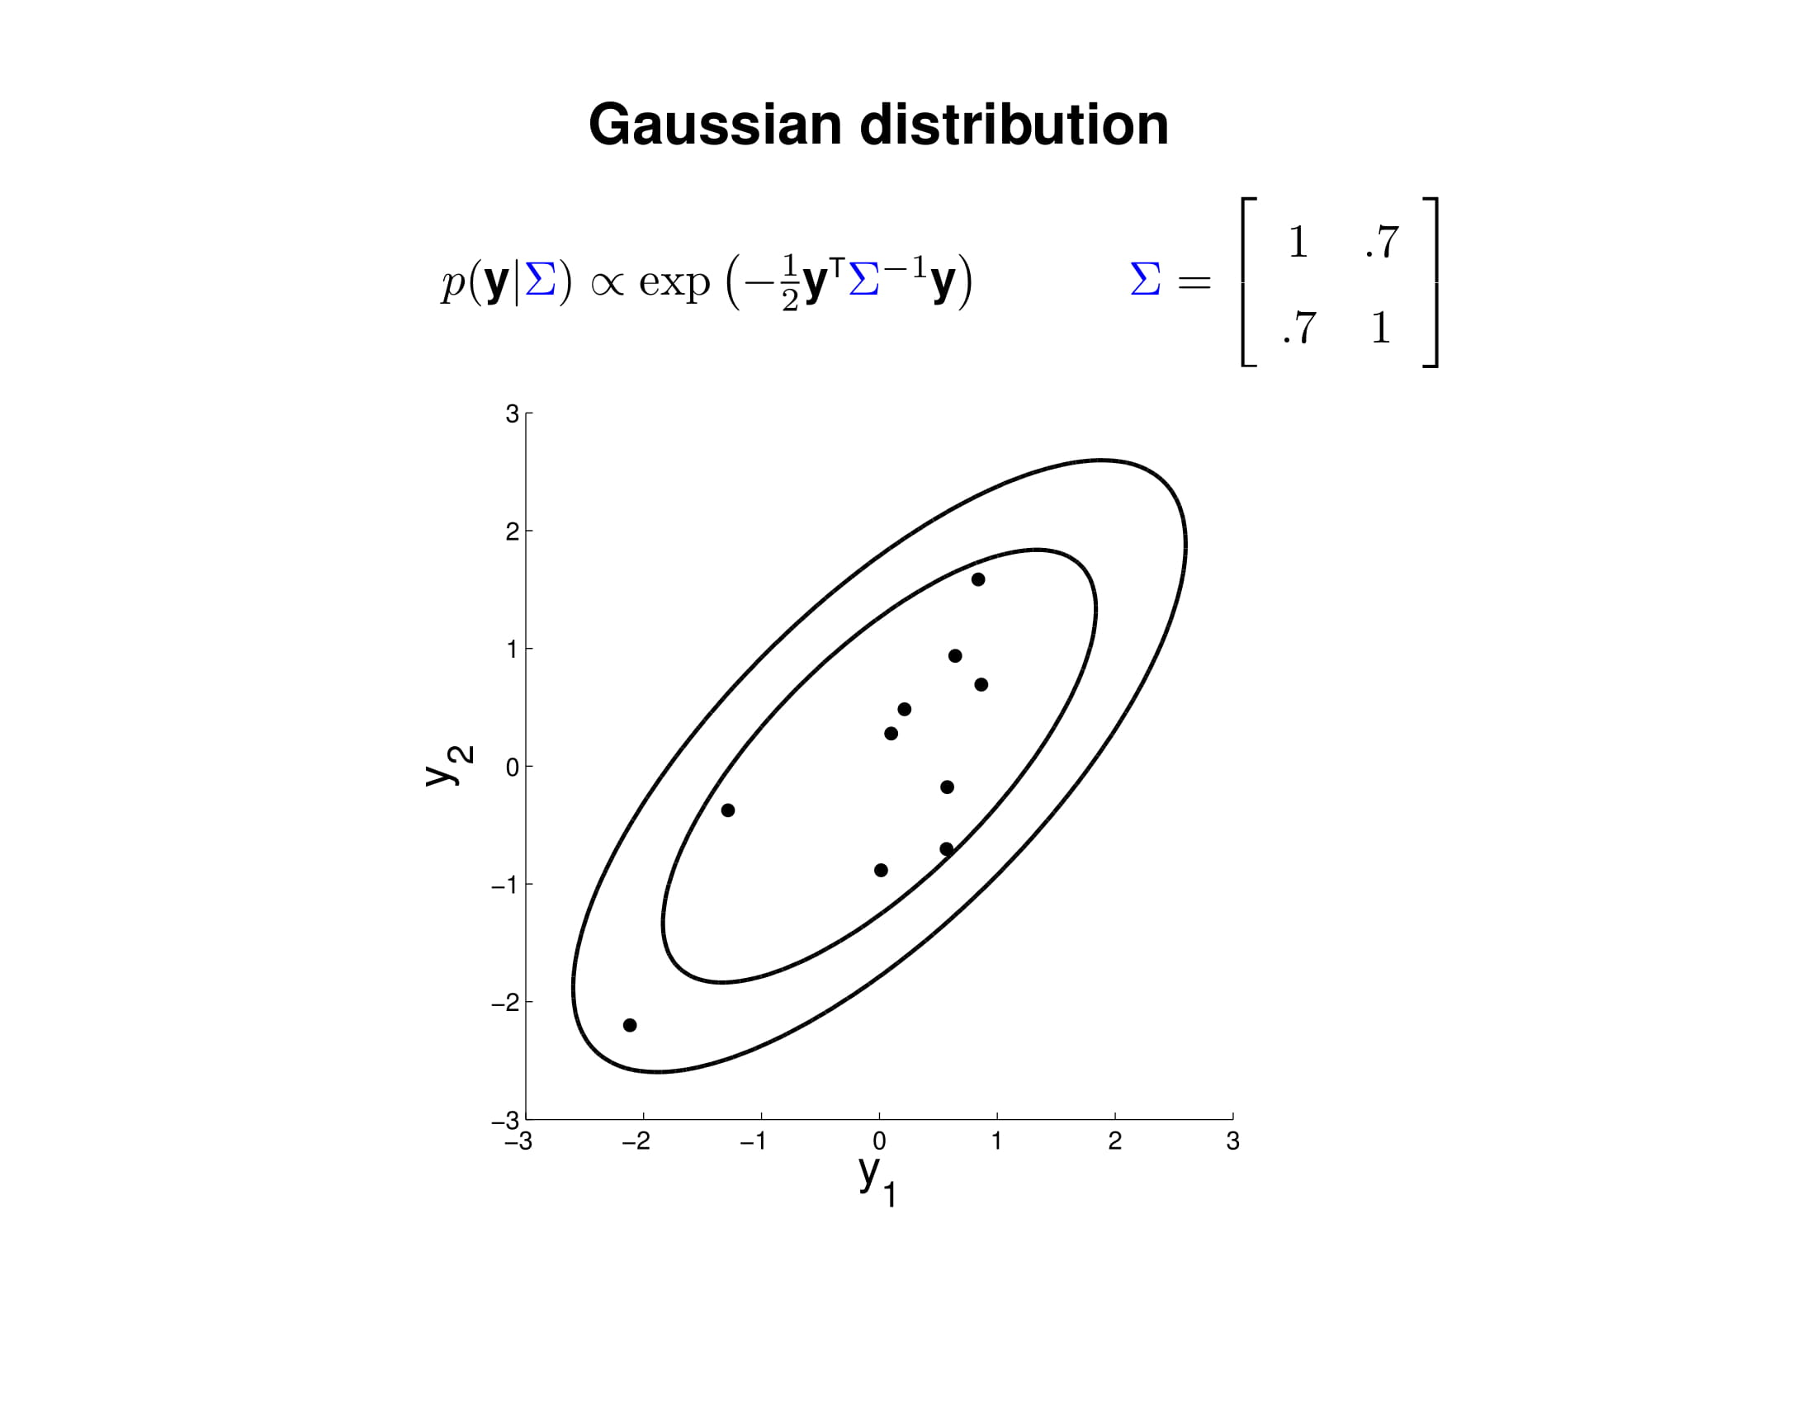
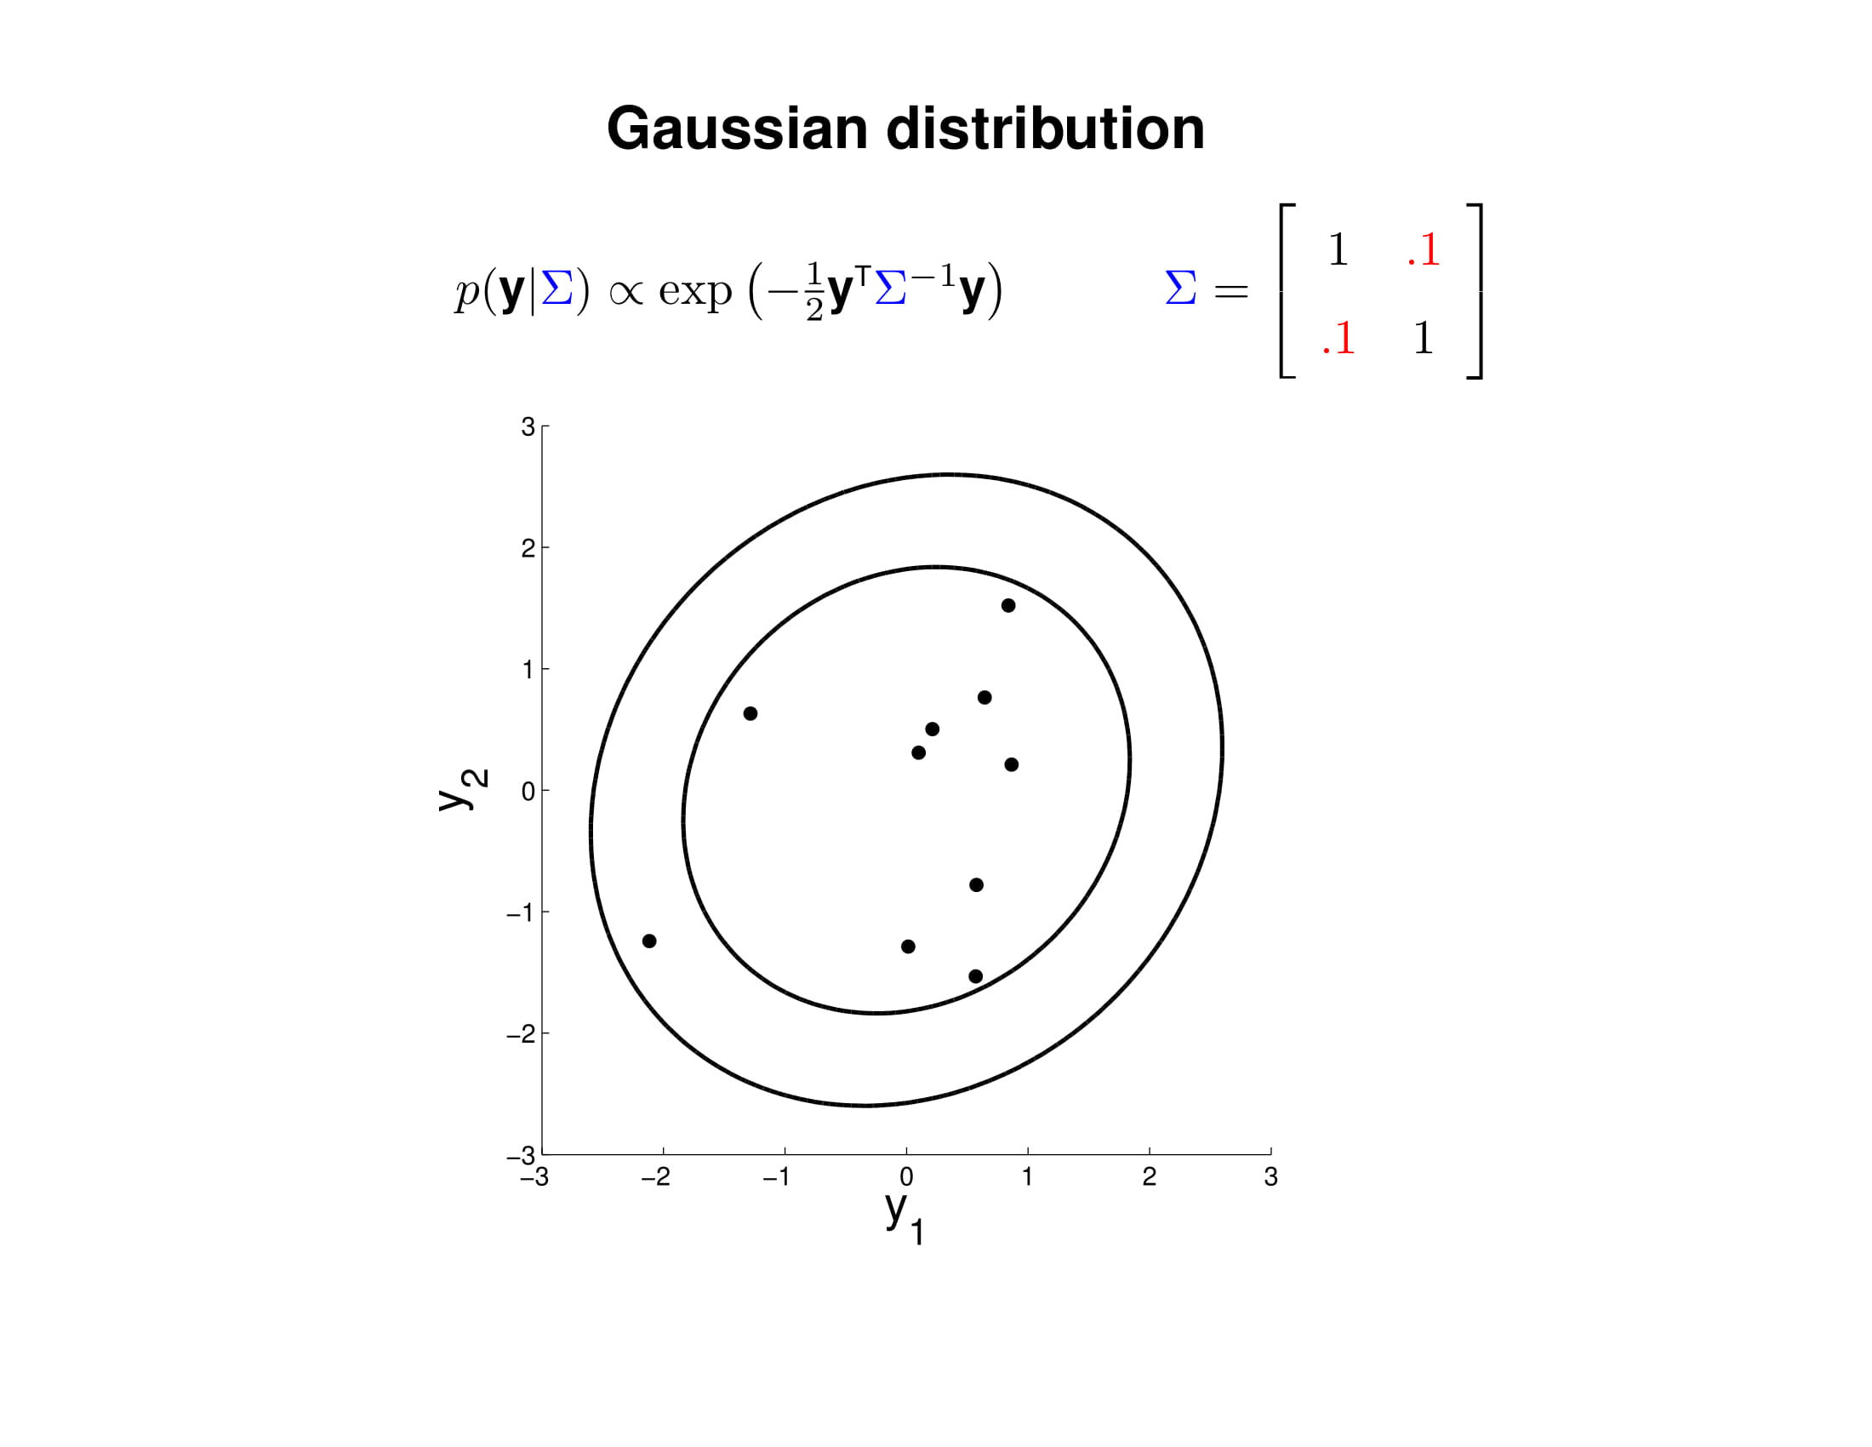

Slide 24
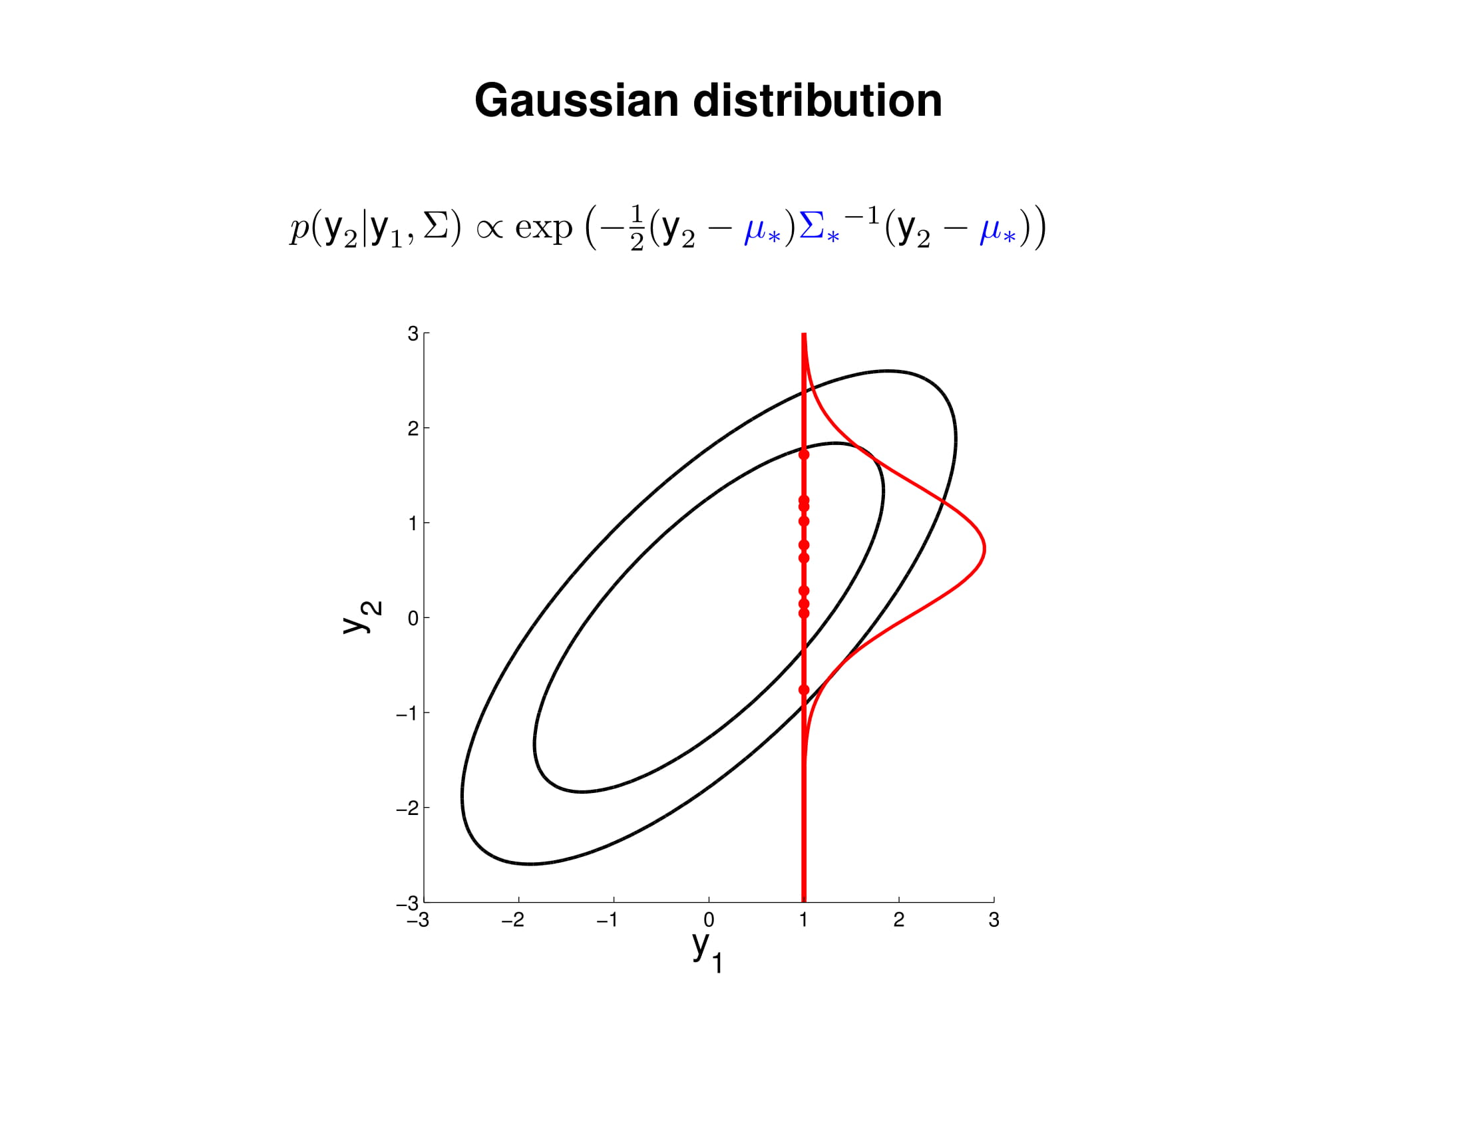
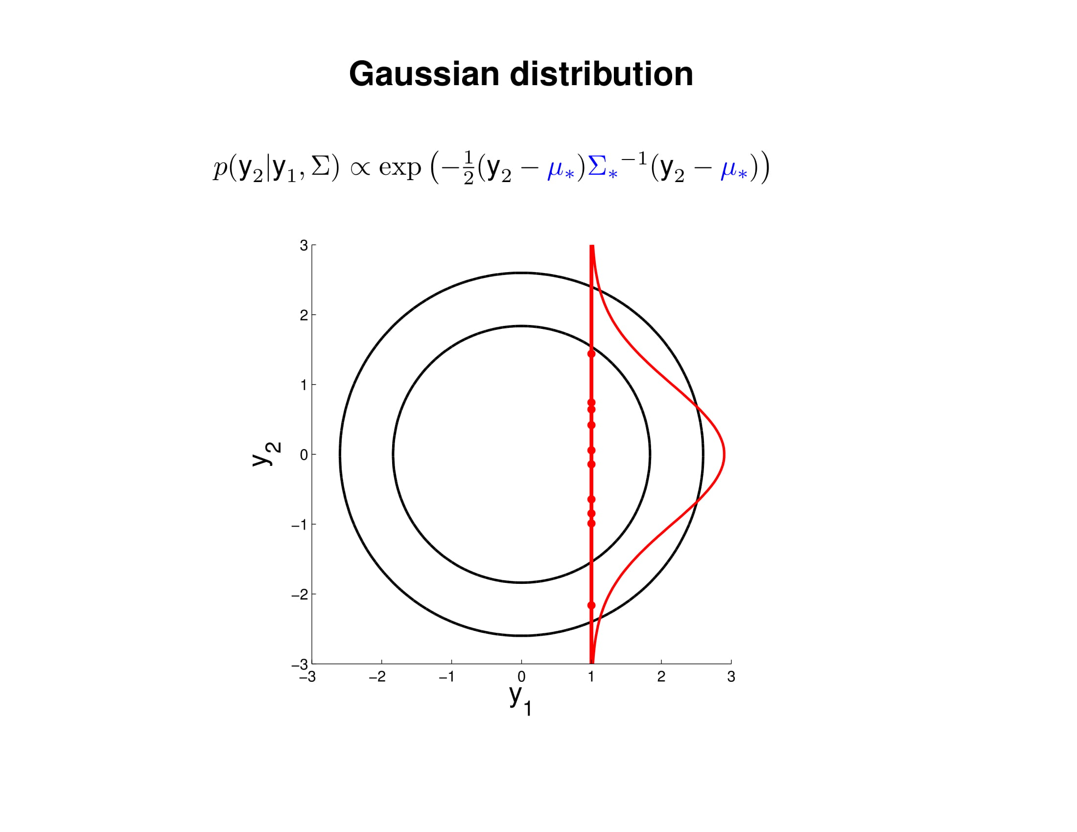

Slide 25
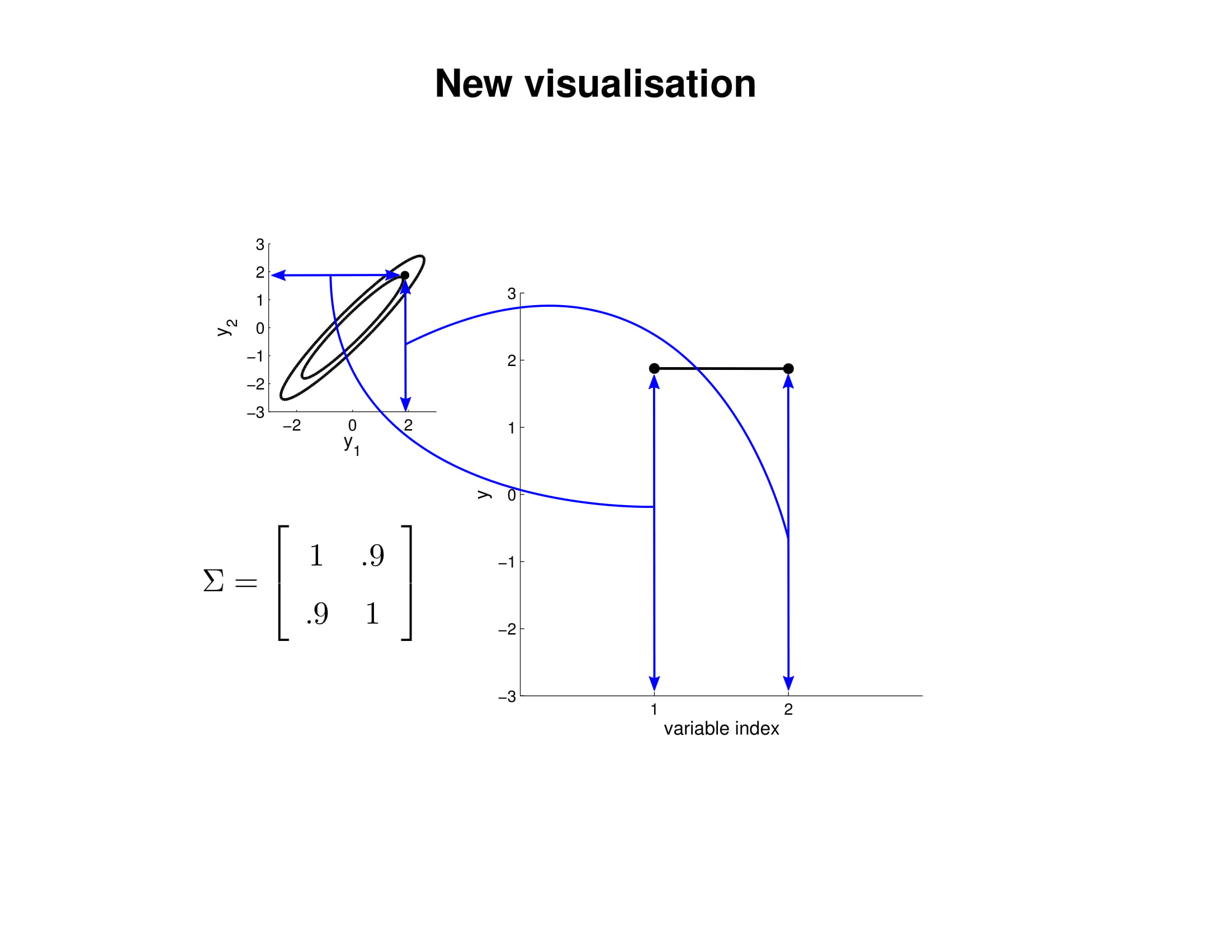

Slide 26
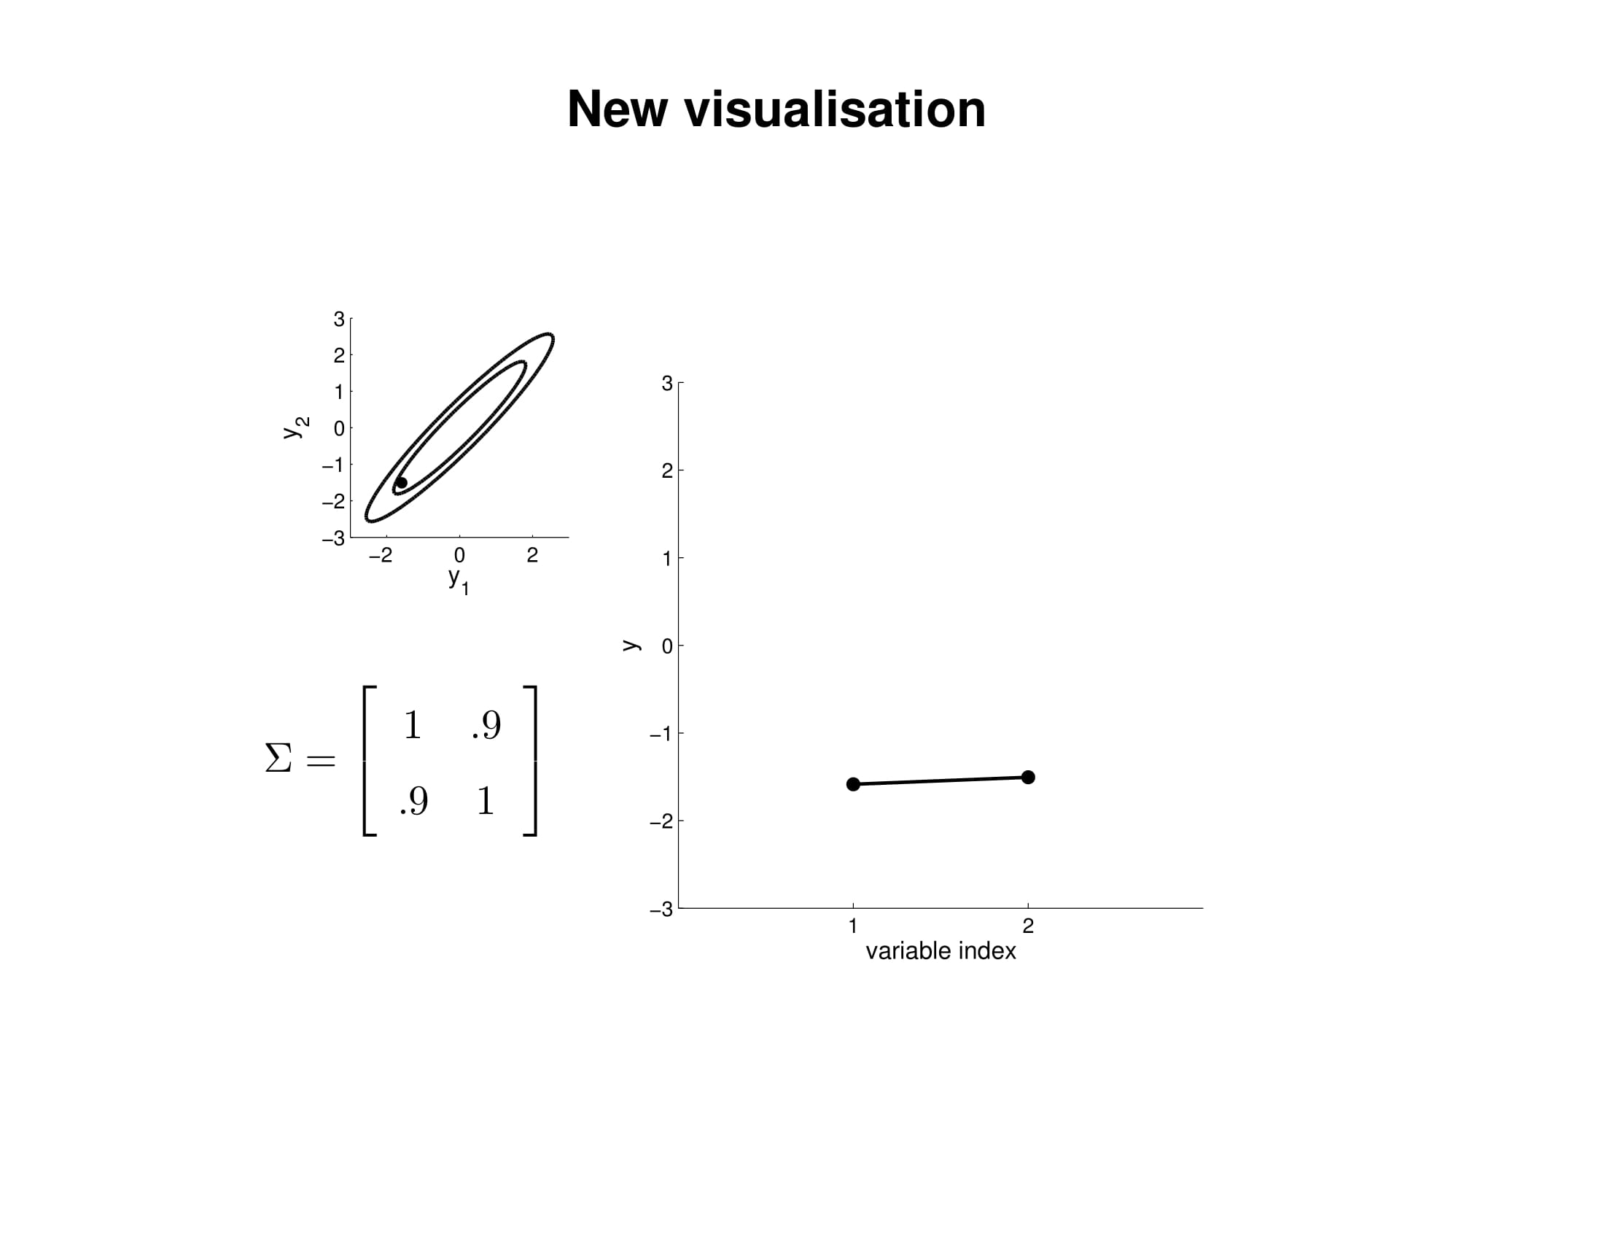

Slide 27
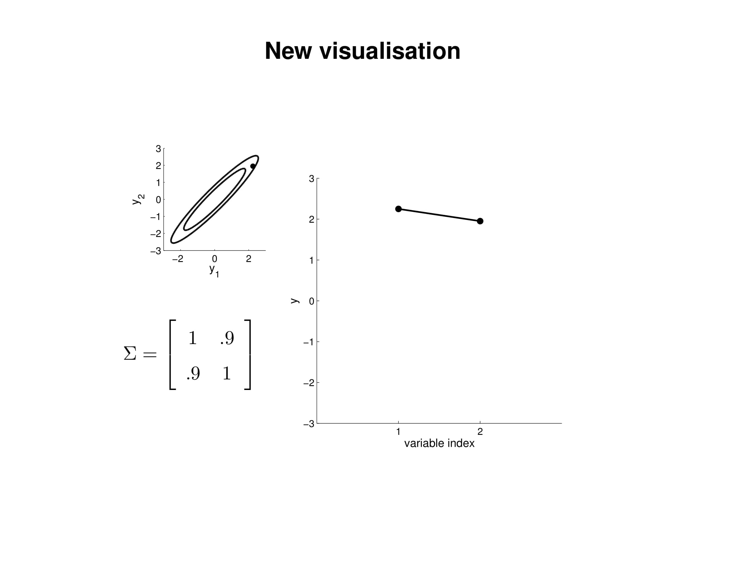

Slide 28
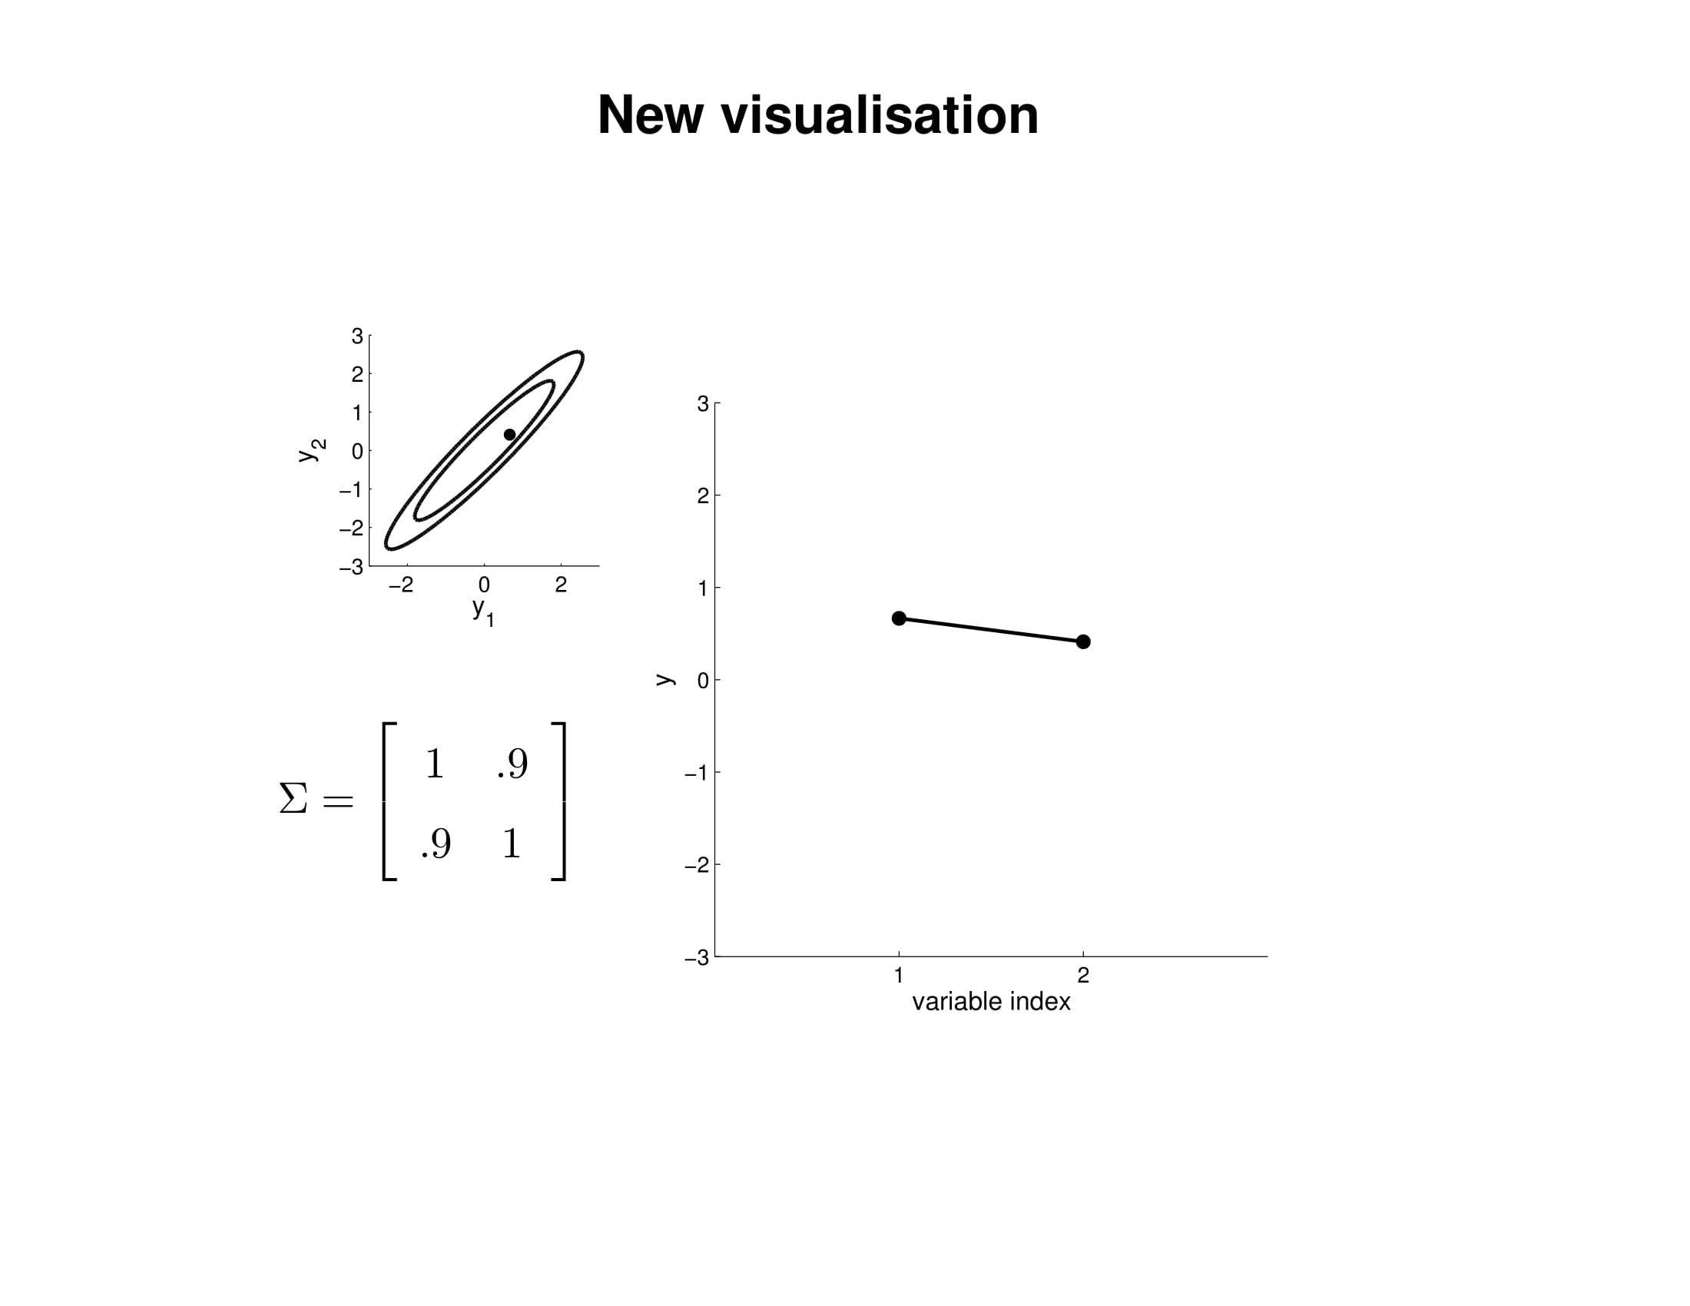

Slide 29
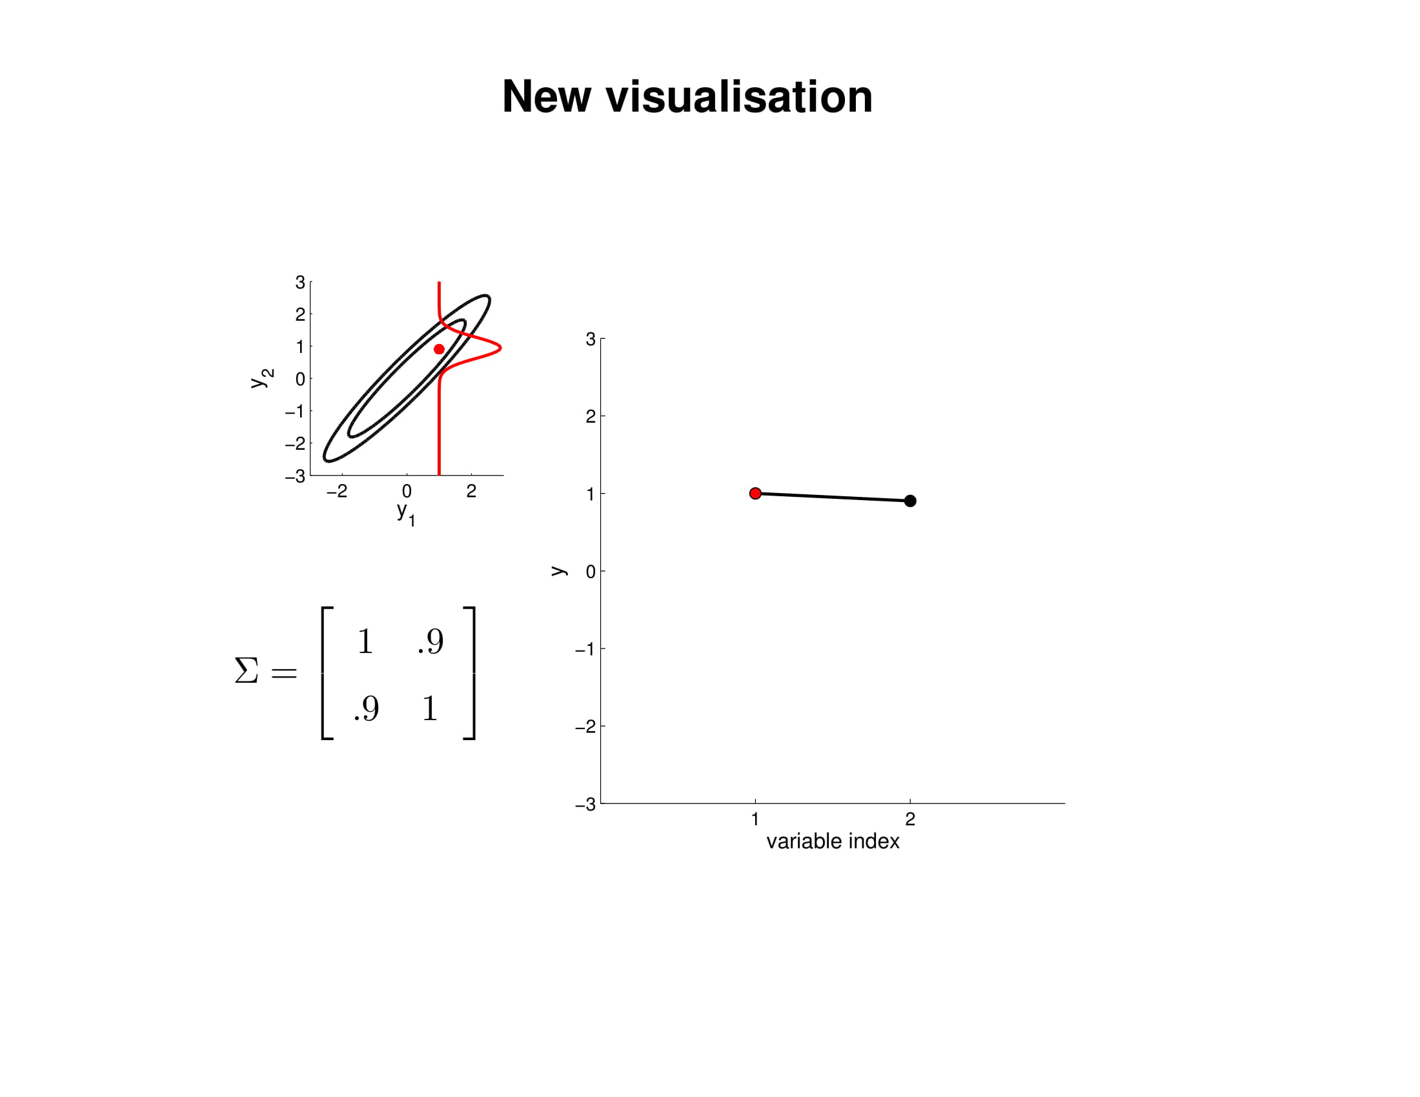

Slide 30
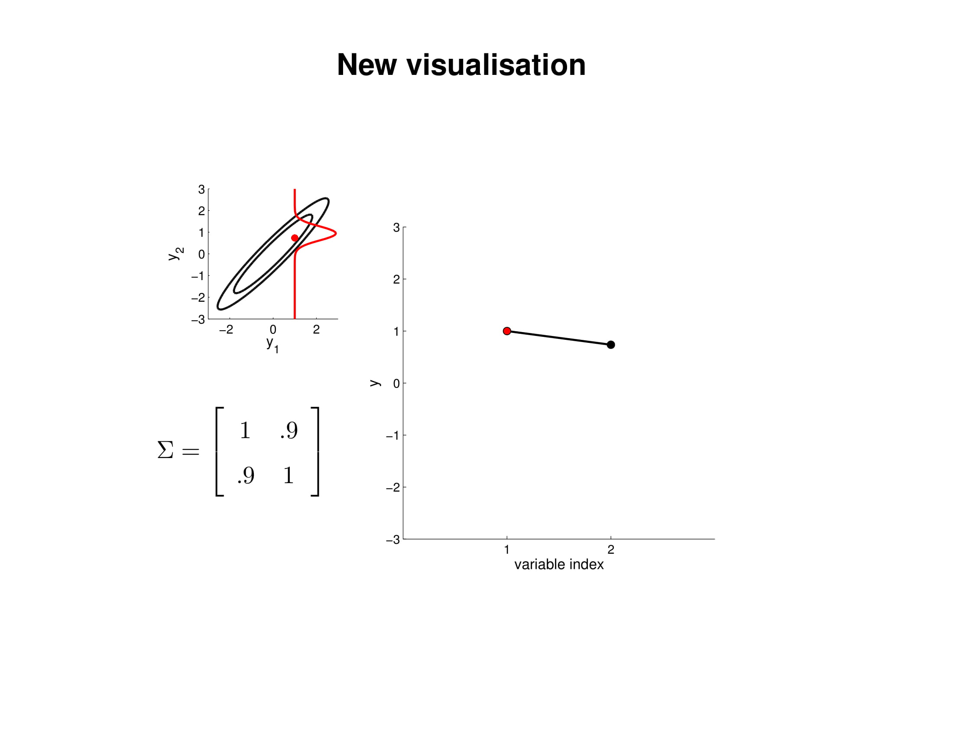

Slide 31


Slide 32
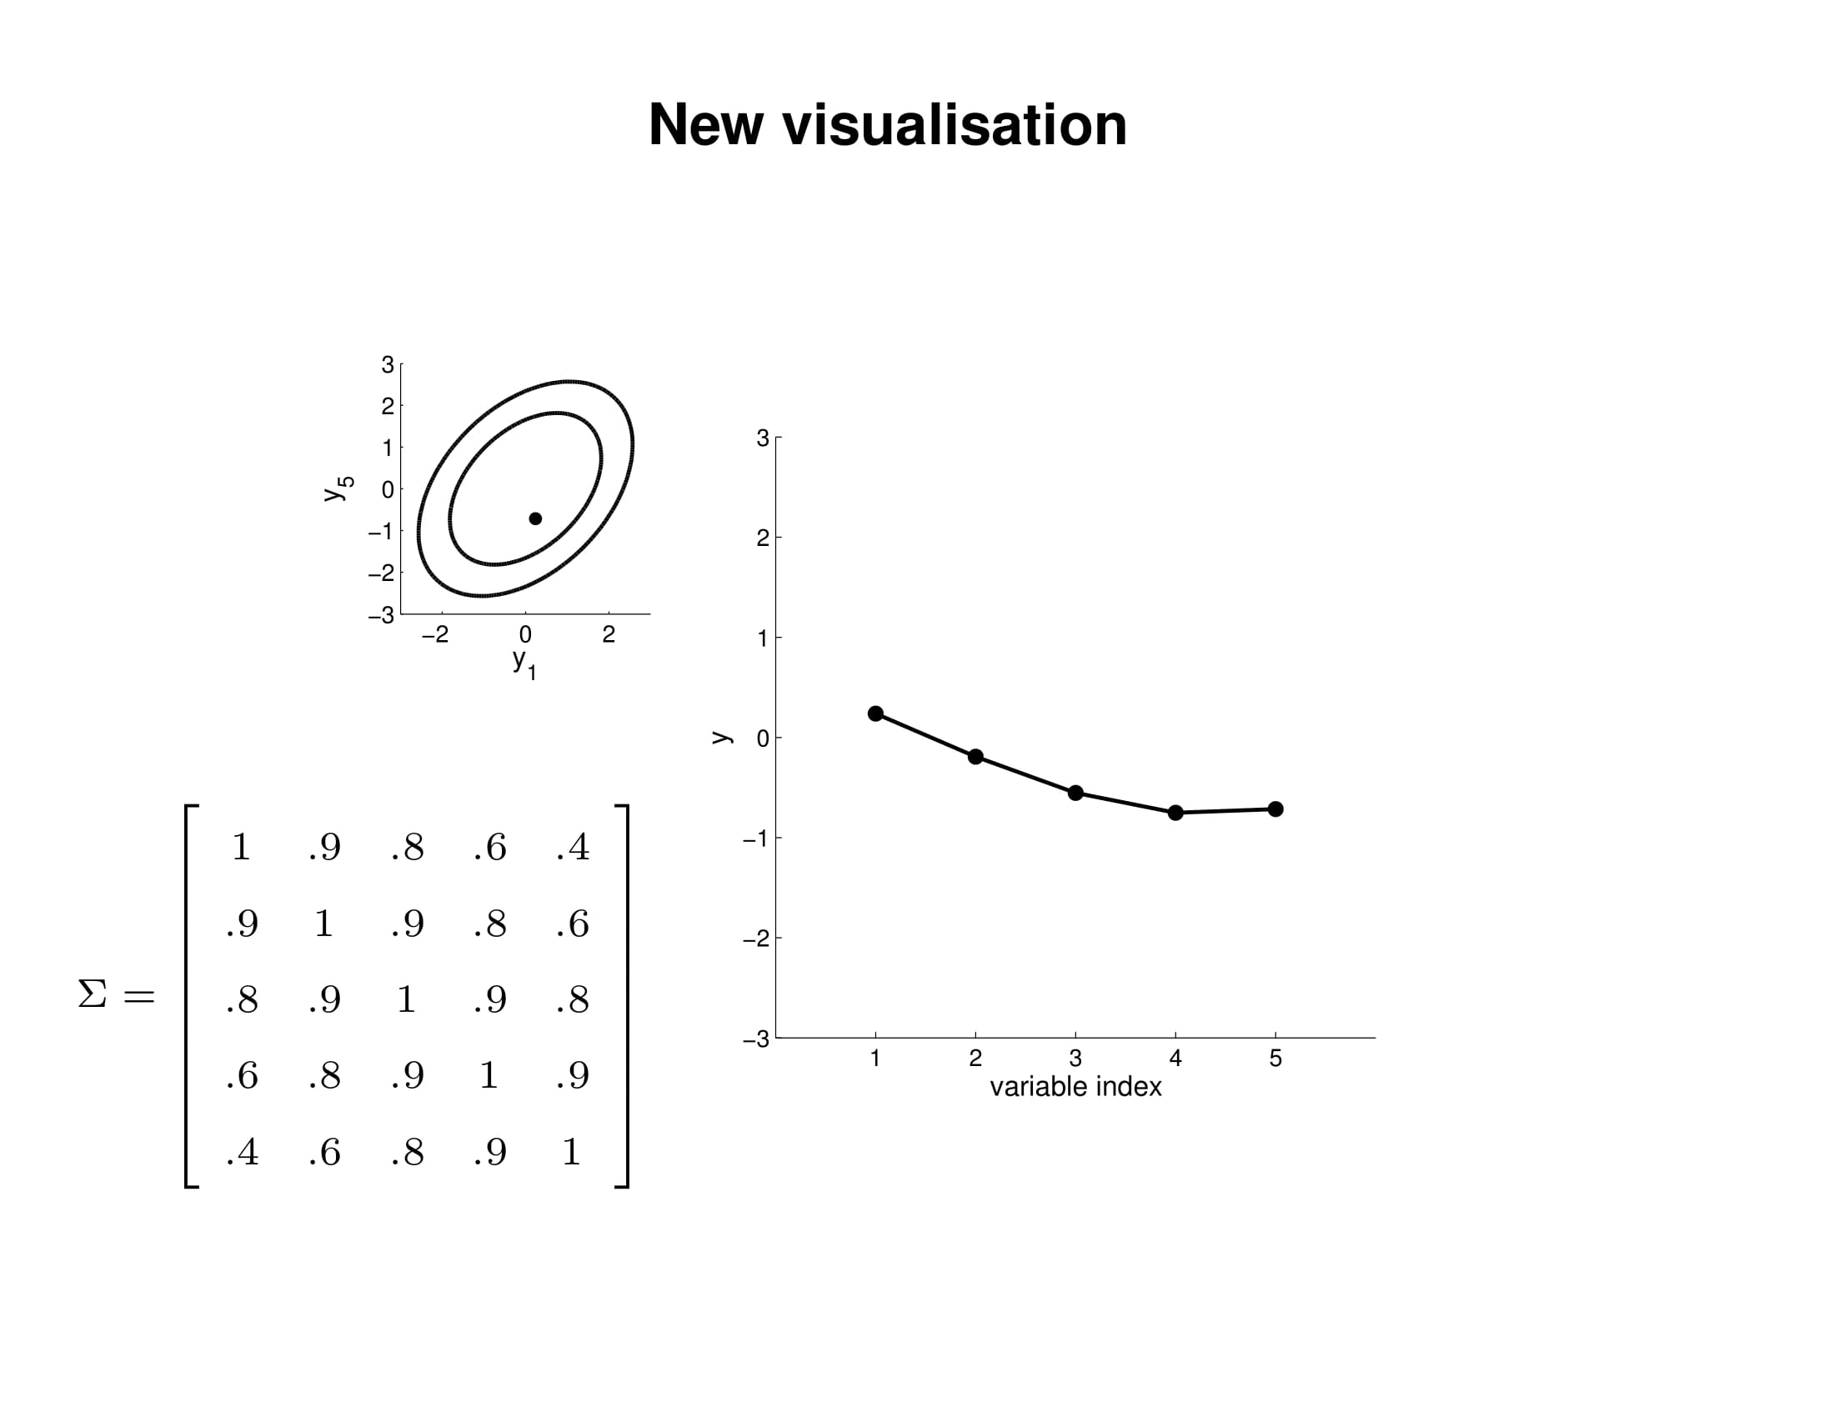

Slide 33
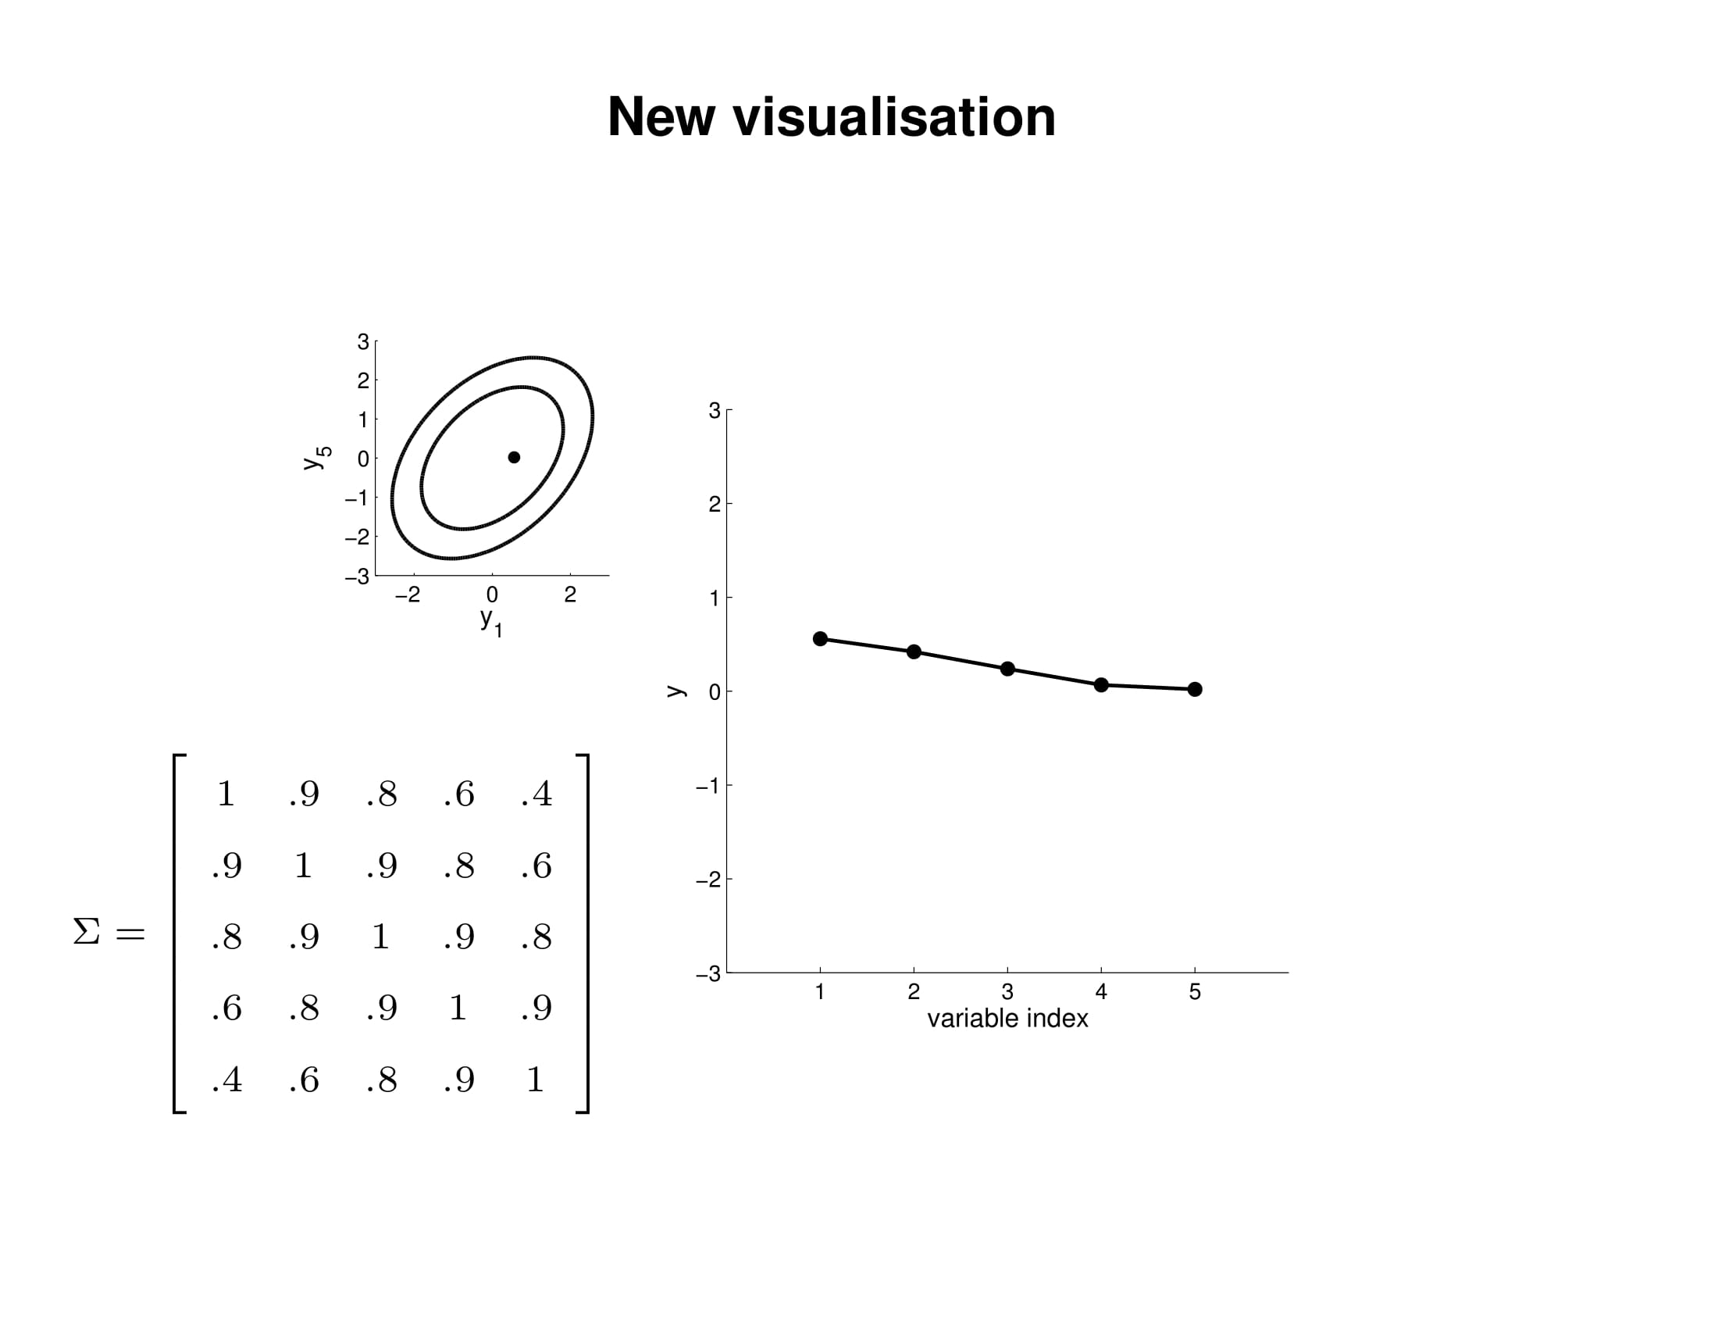

Slide 34
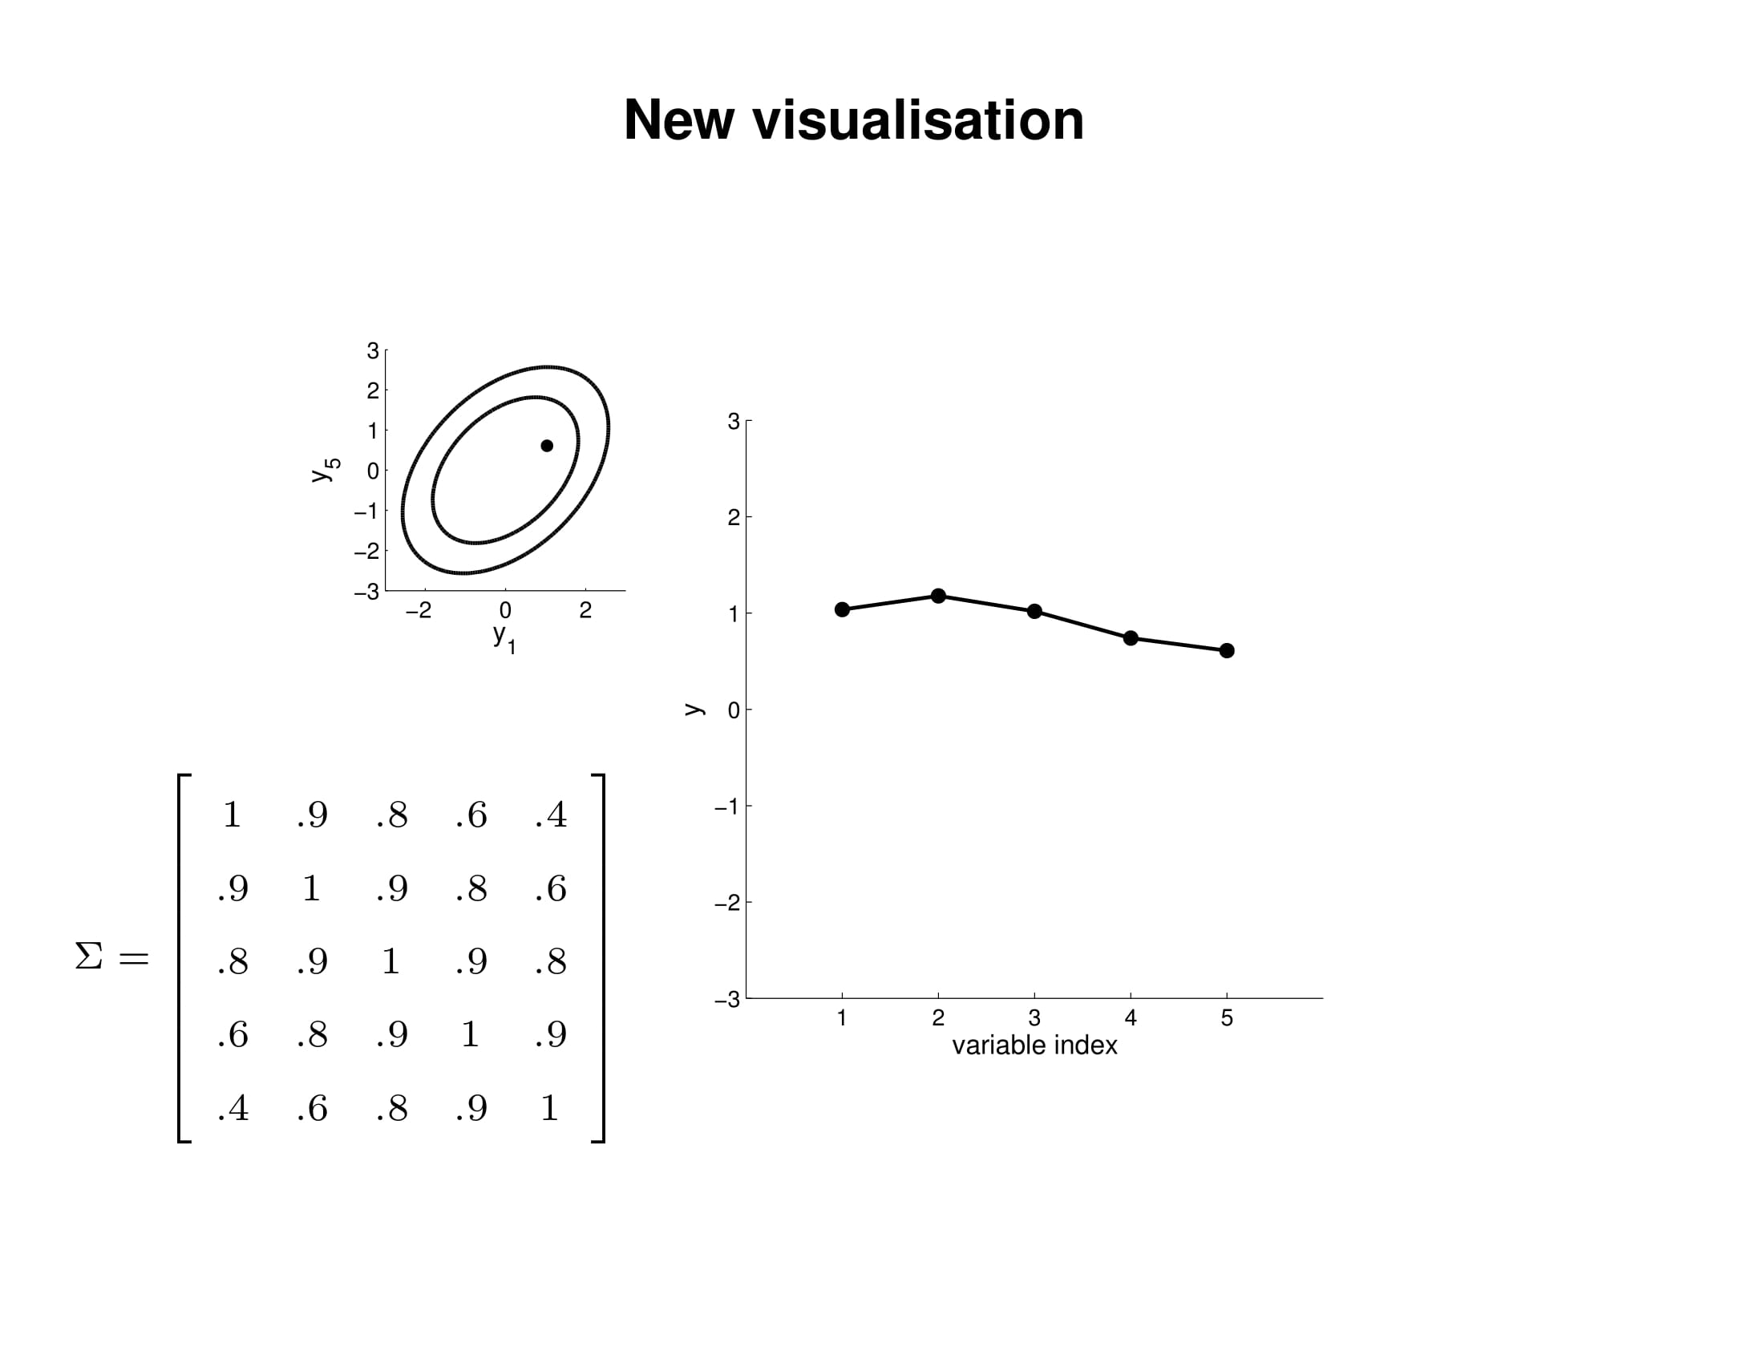

Slide 35
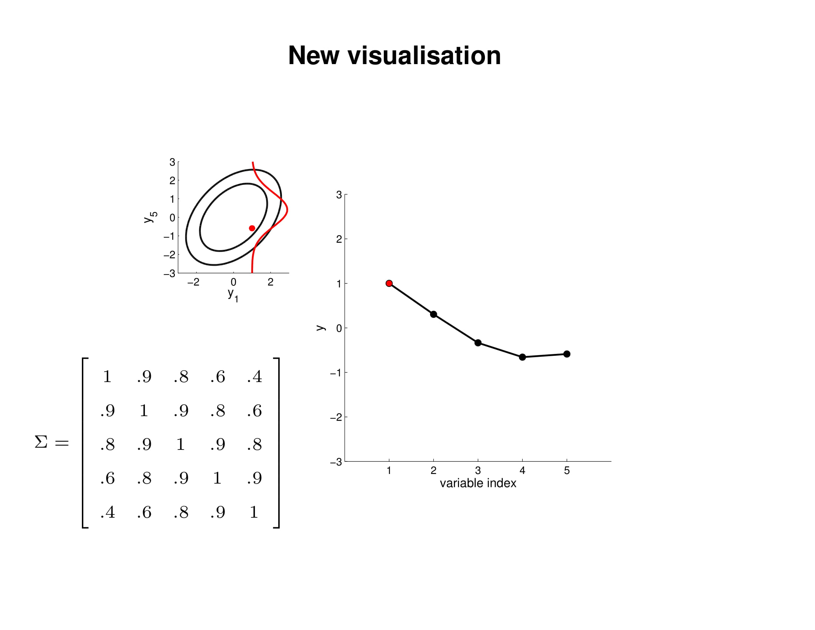

Slide 36
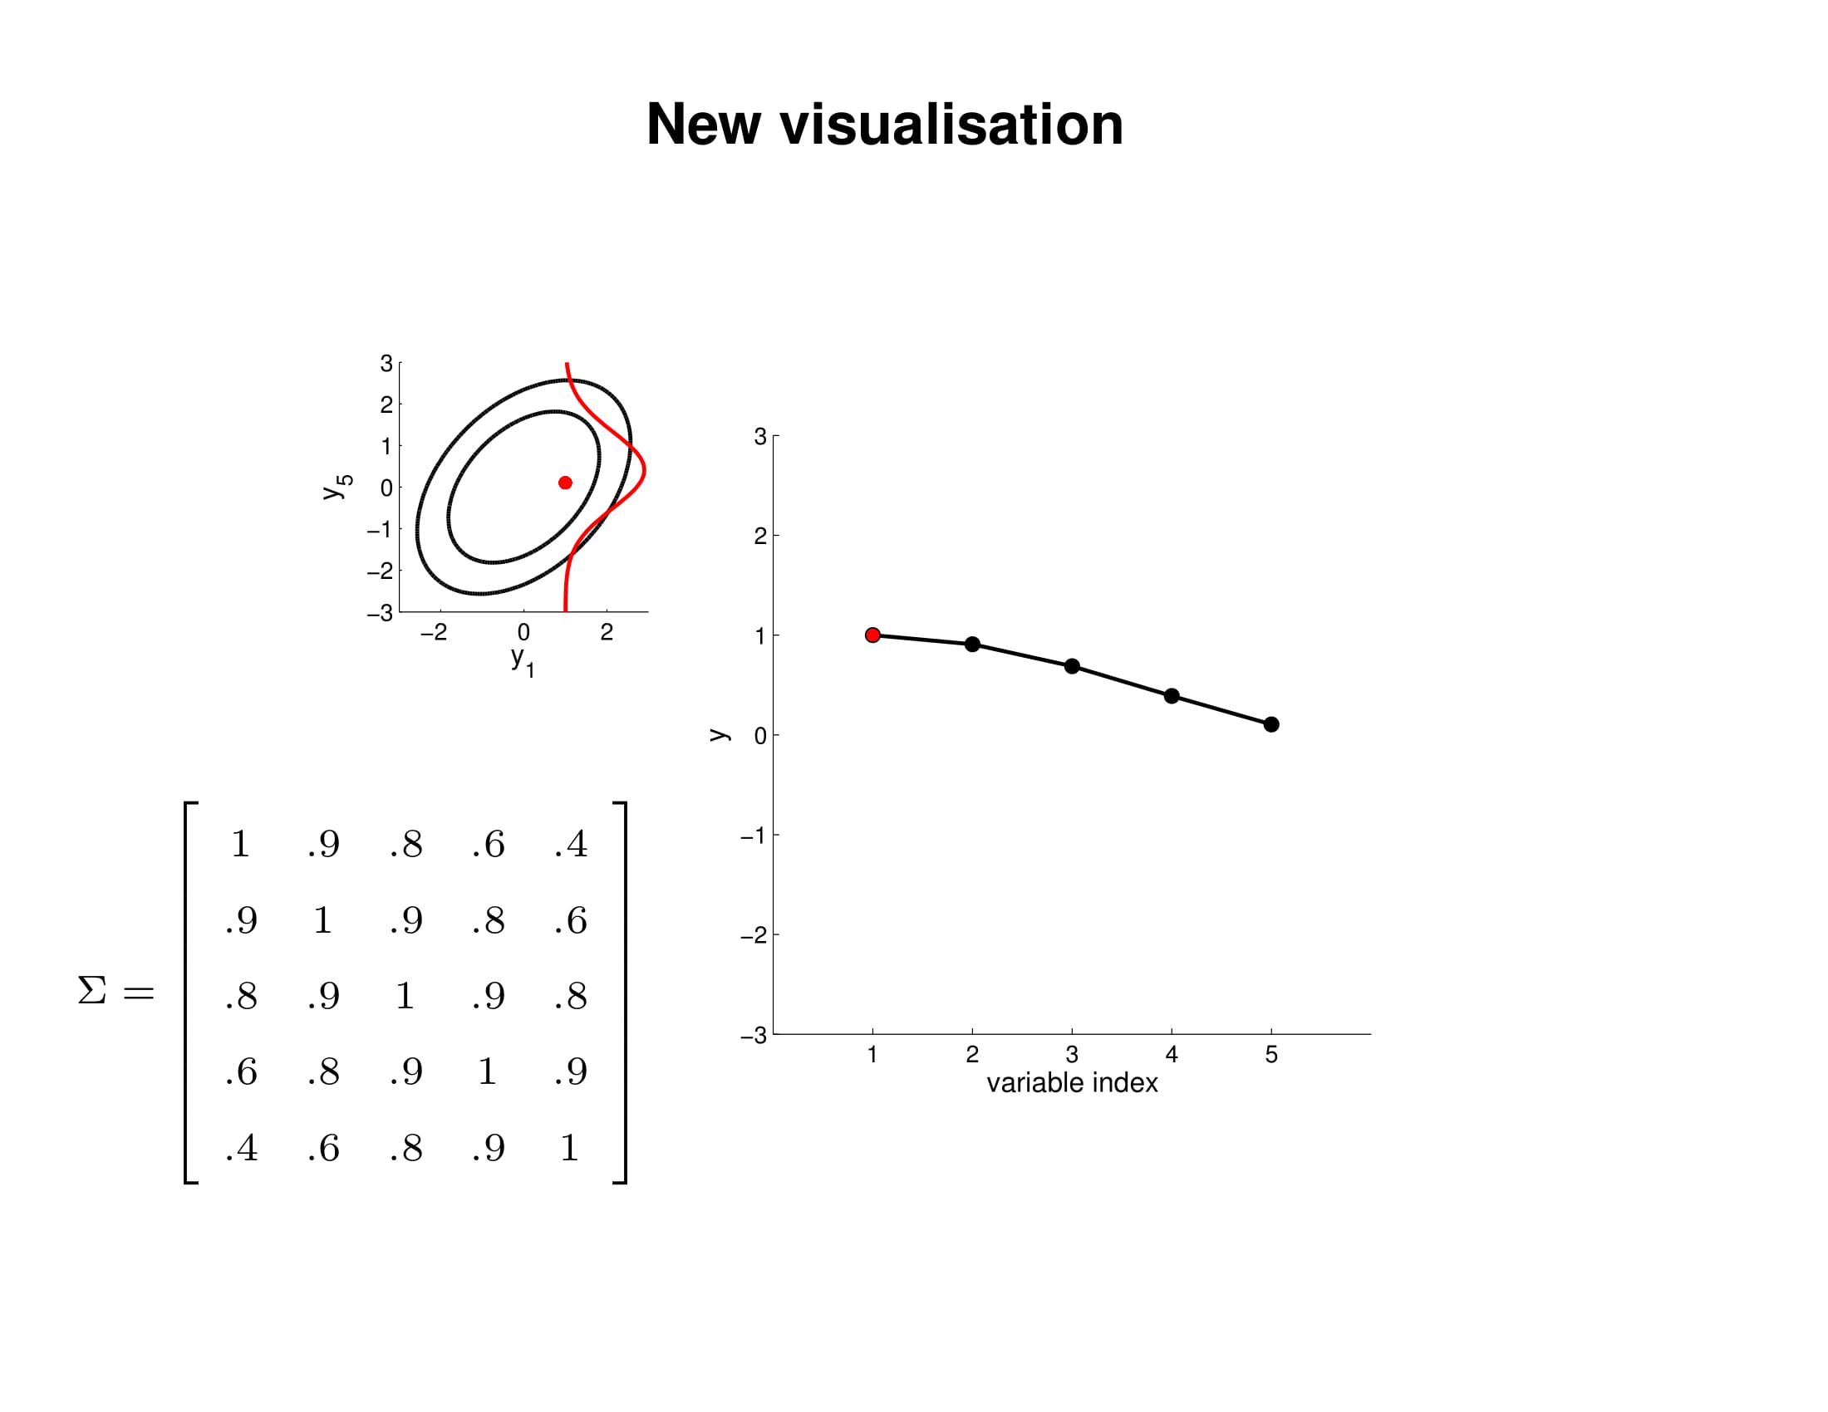

Slide 37
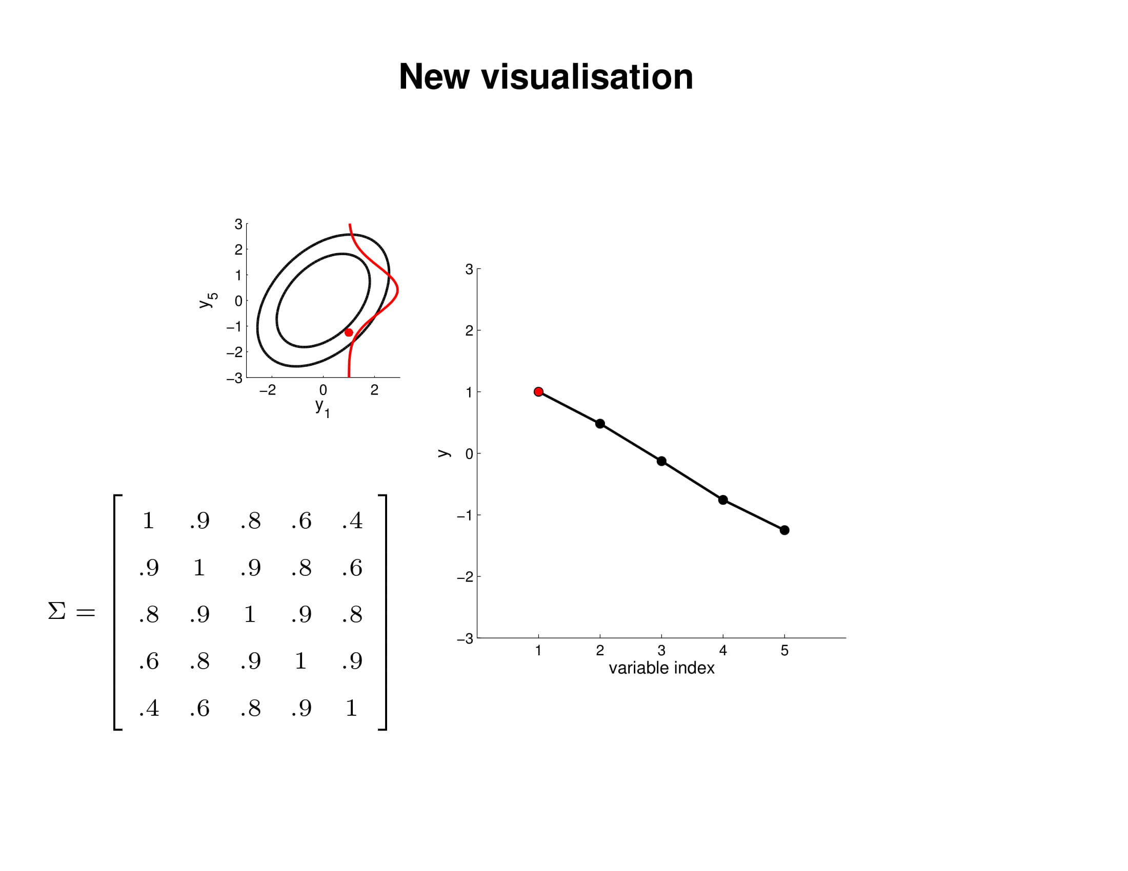

Slide 38
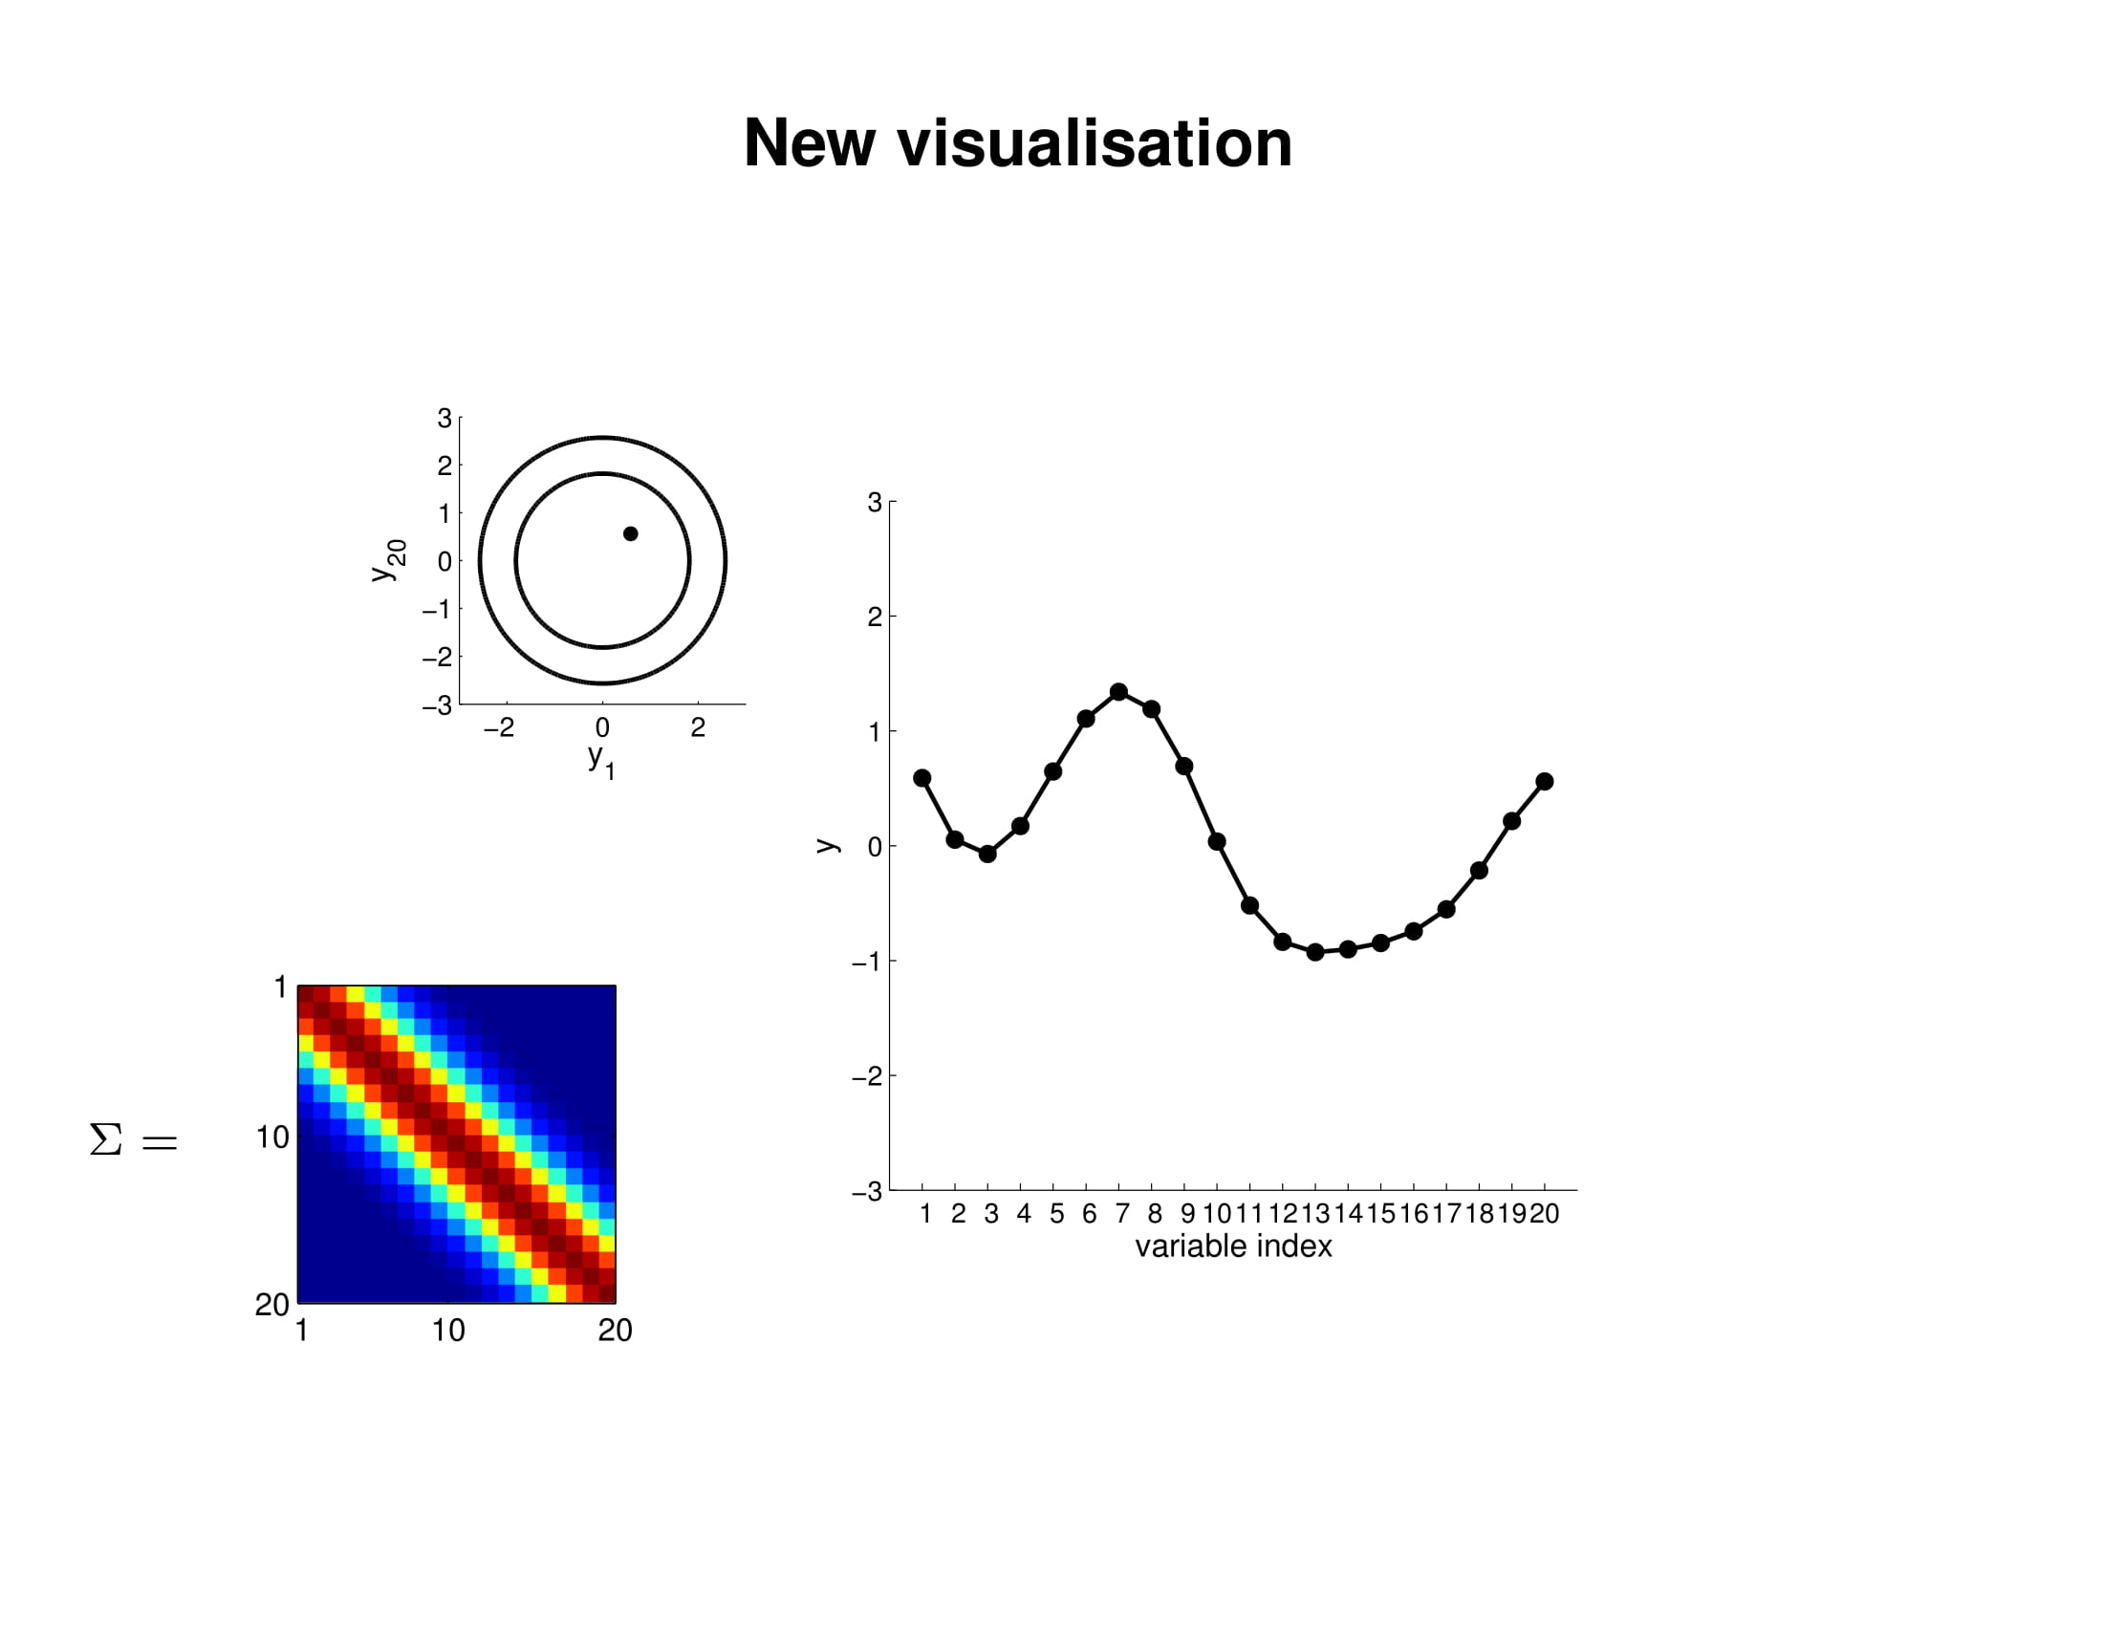

Slide 39
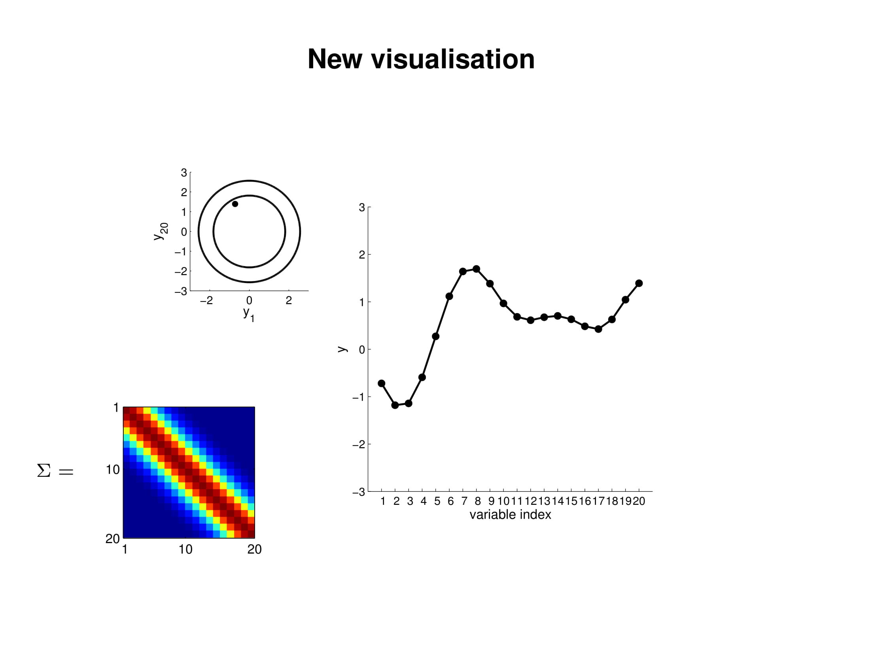

Slide 40


Slide 41
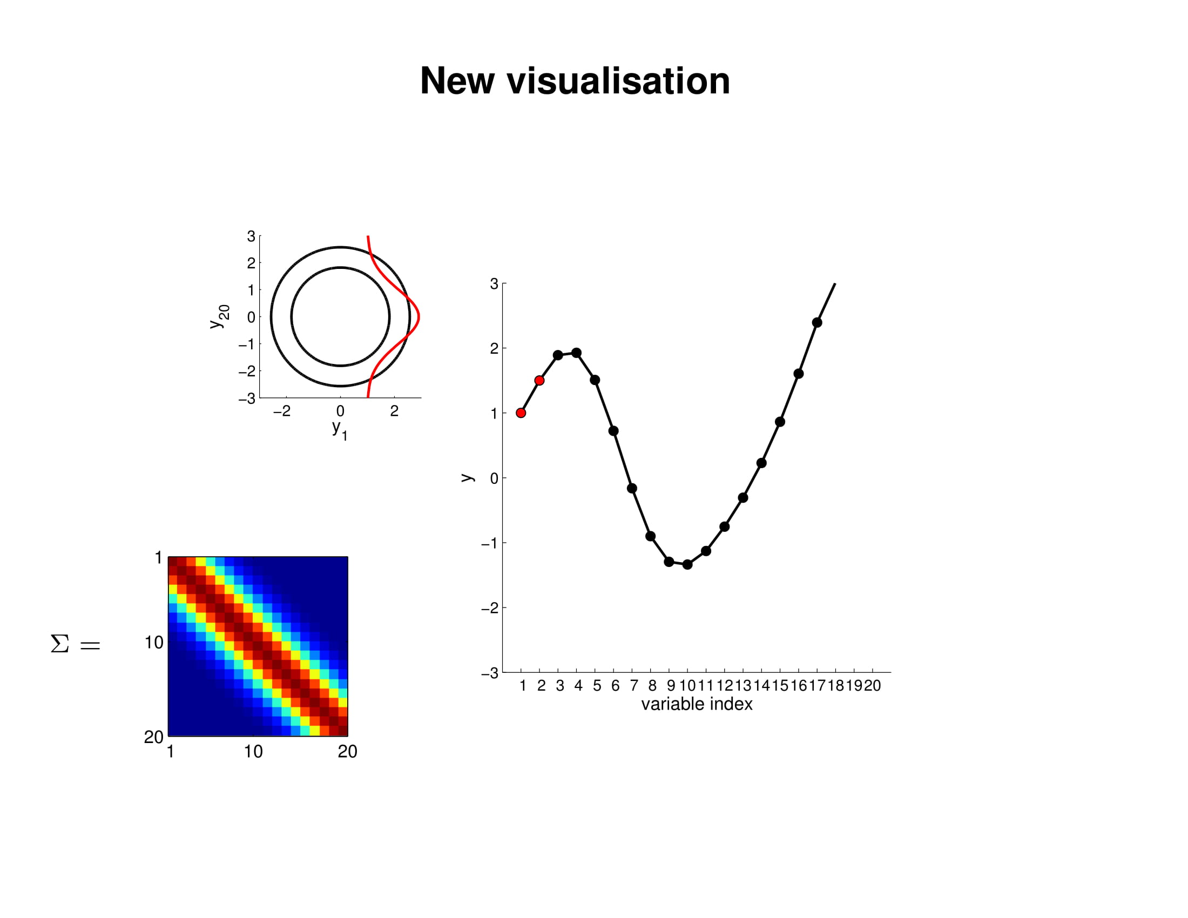

Slide 42


Slide 43


Slide 44
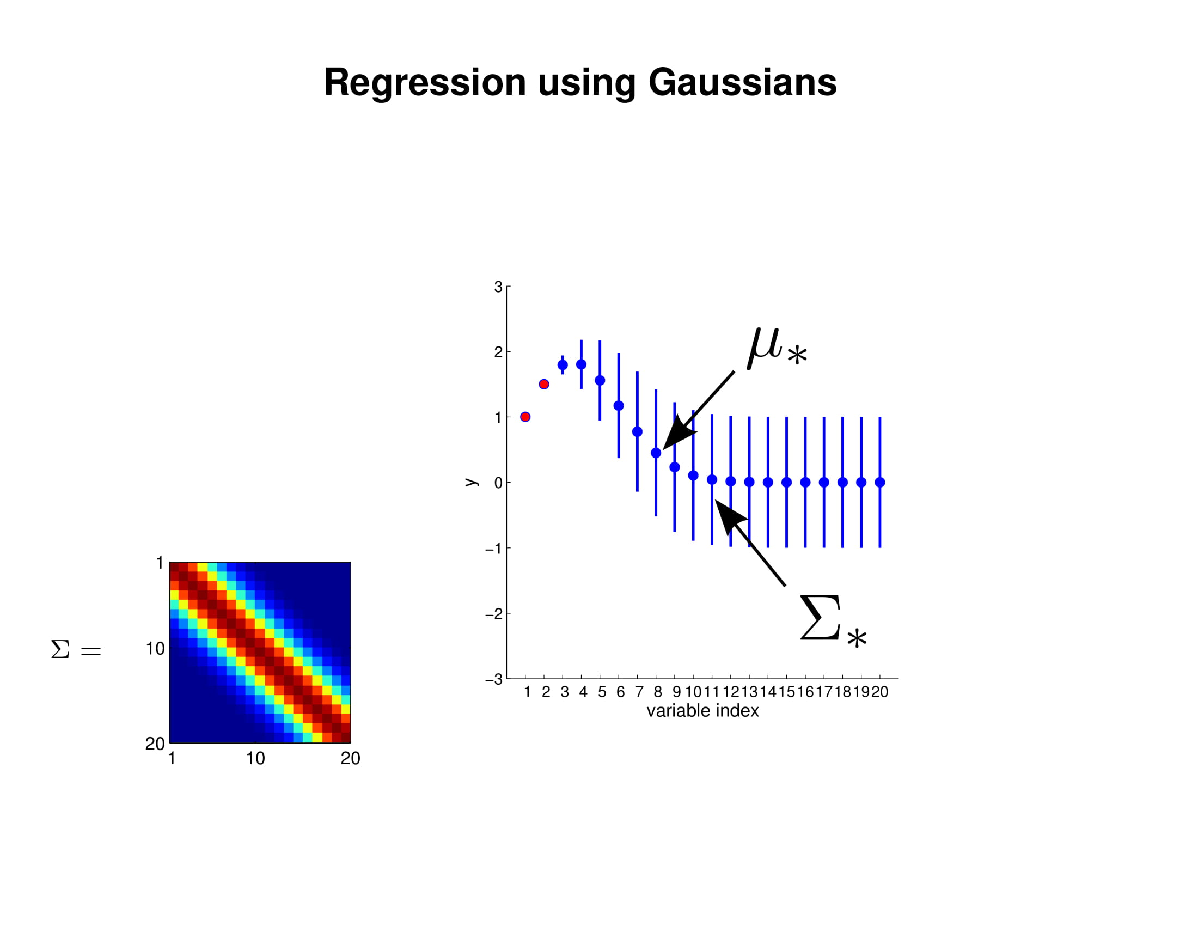

Slide 45
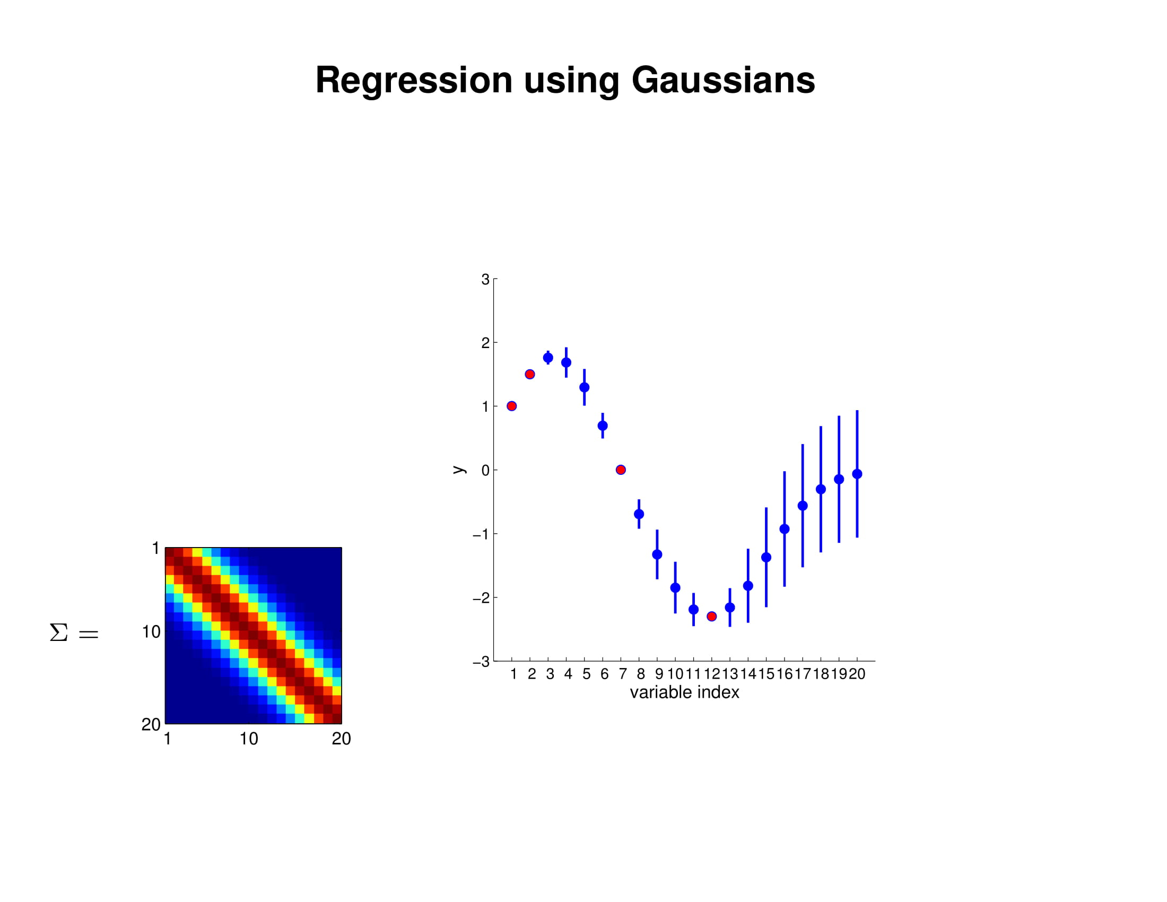

Slide 46
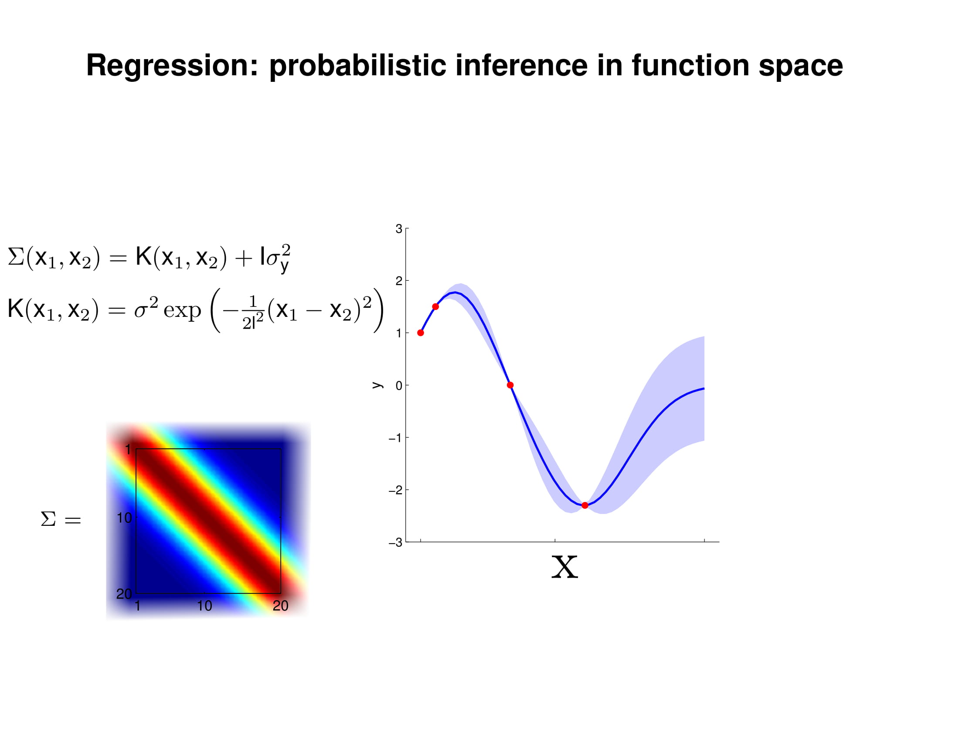

Slide 47
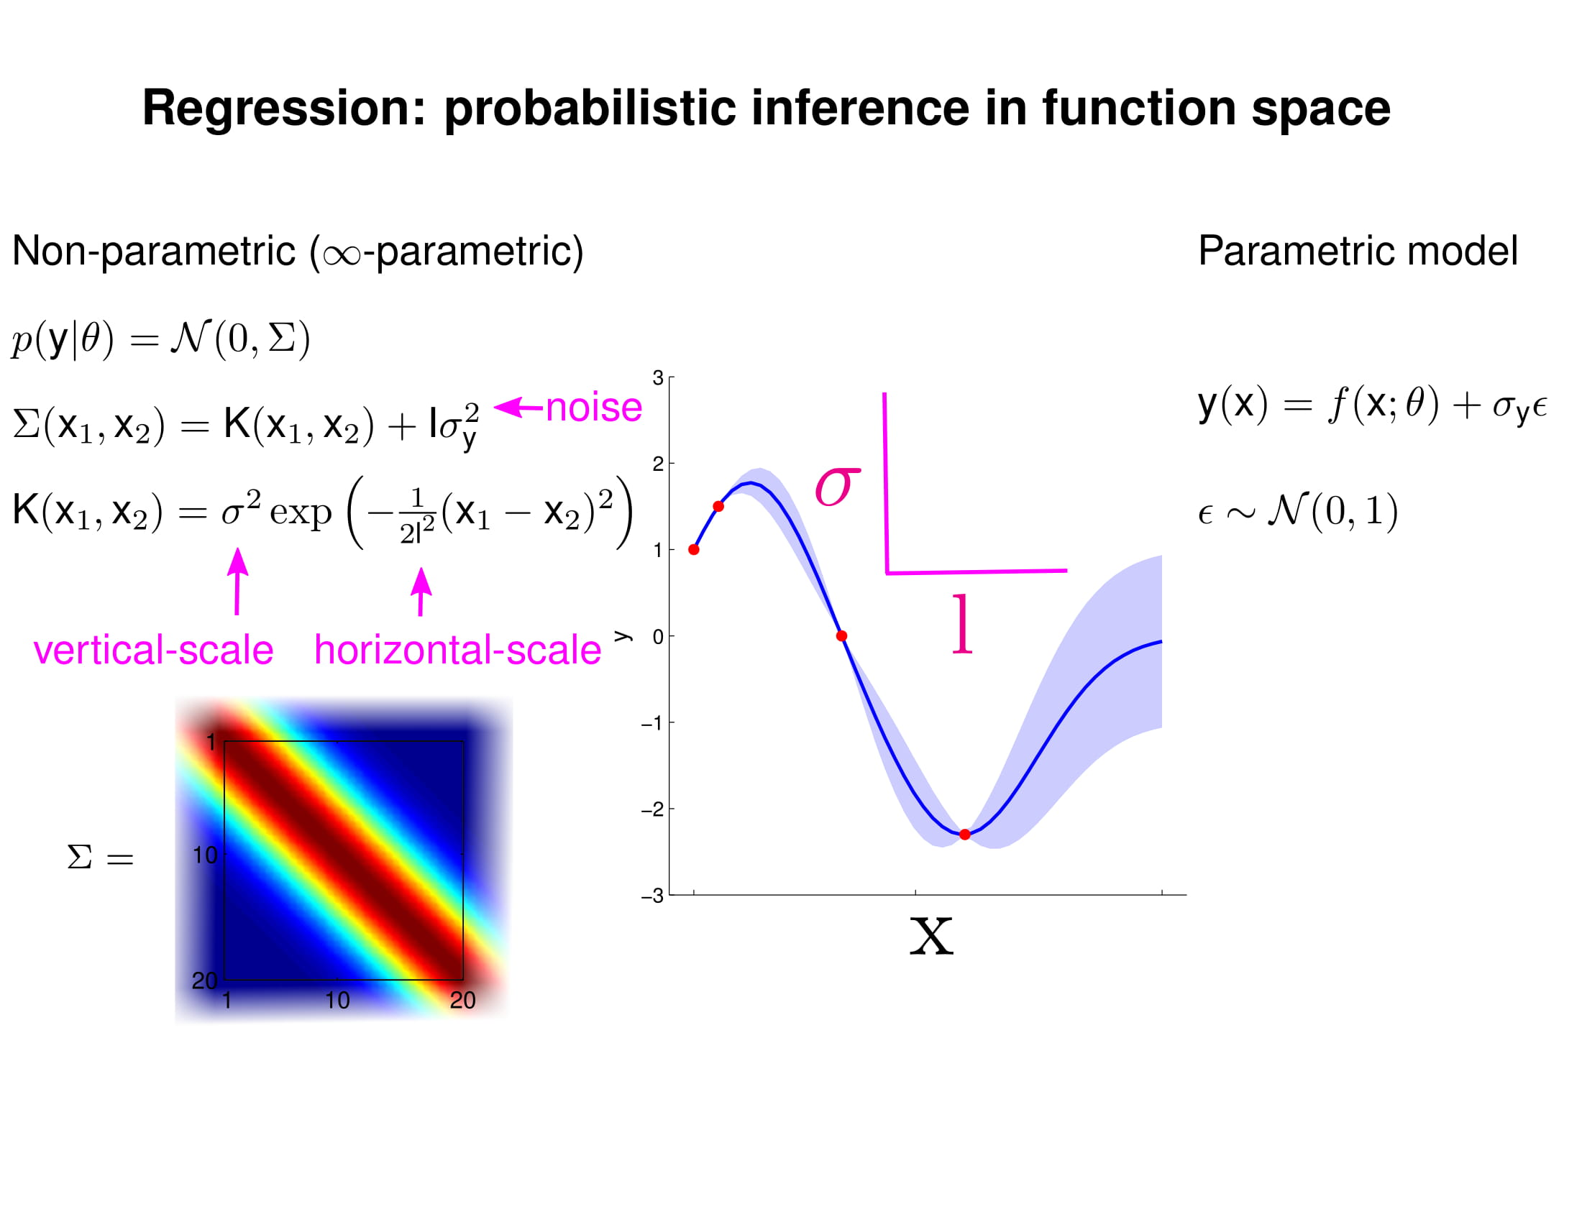

Slide 48
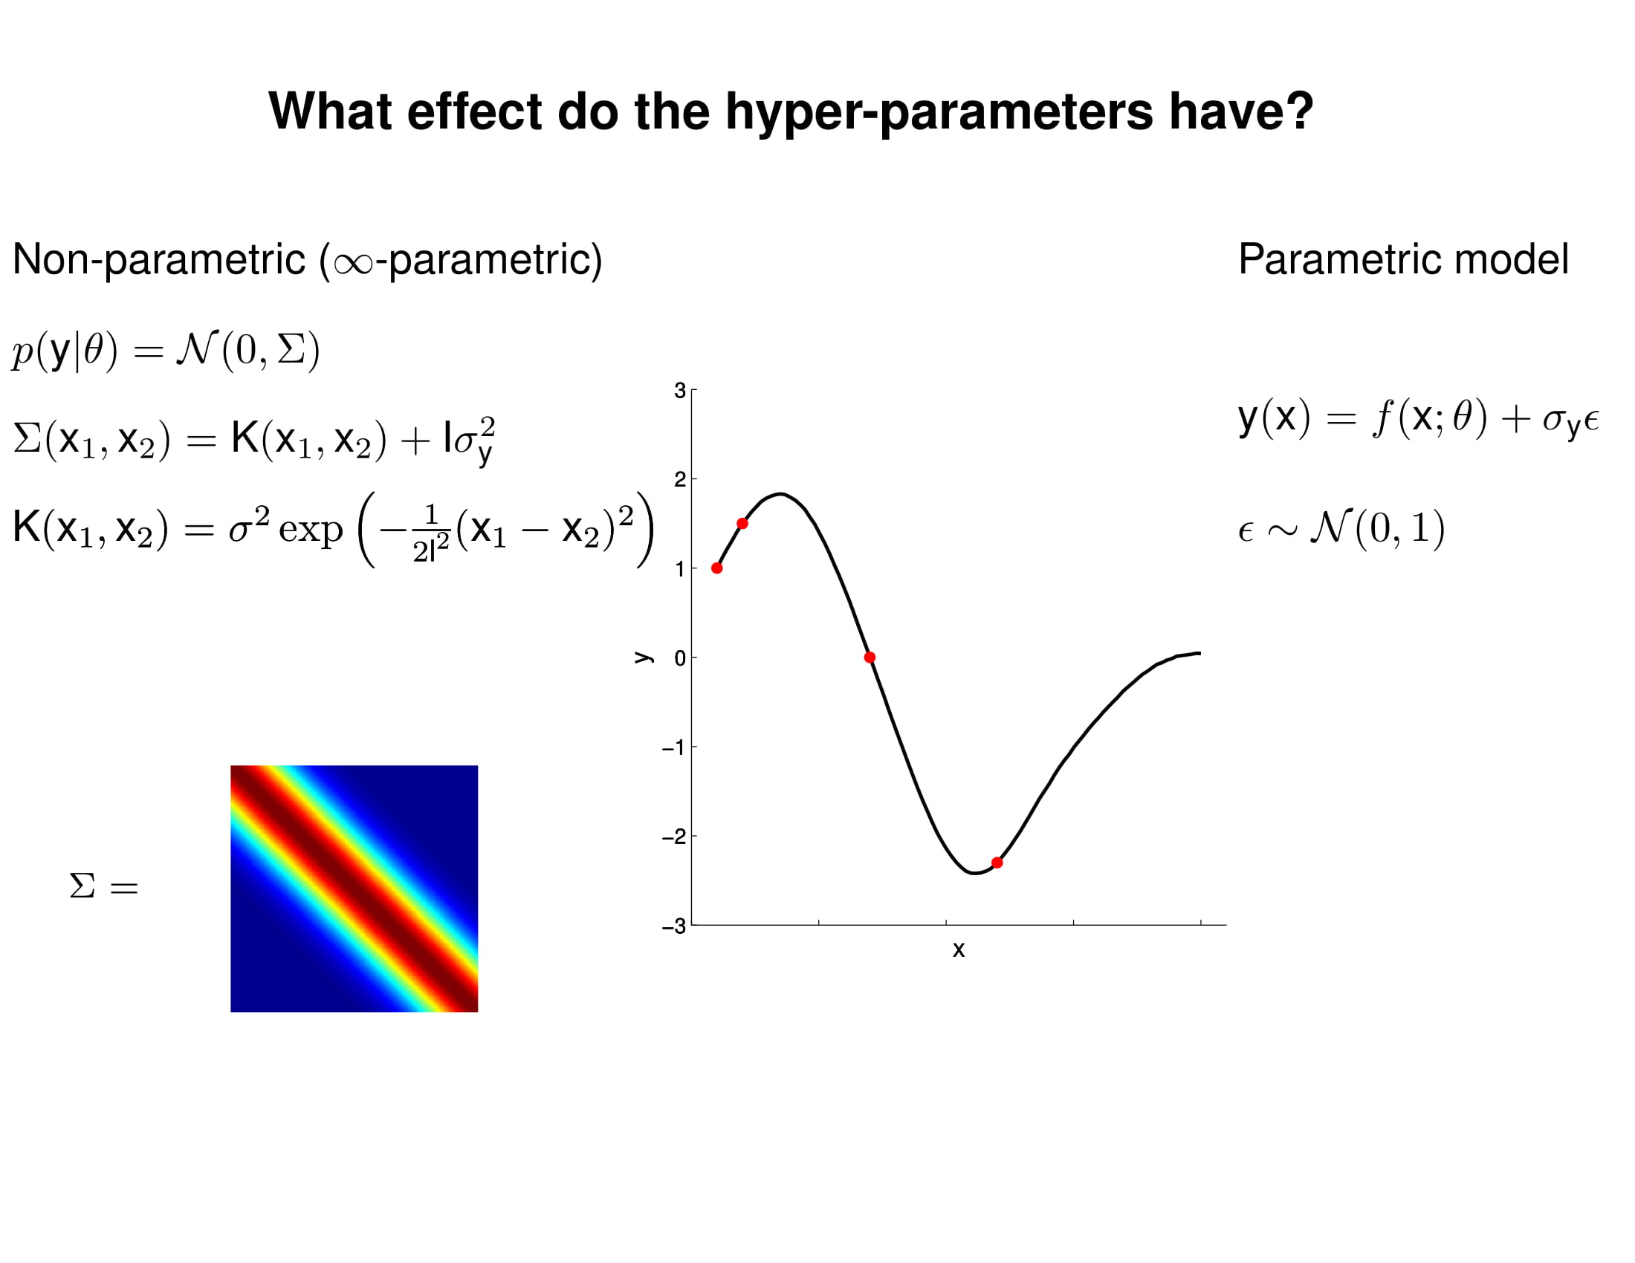

Slide 49


Slide 51
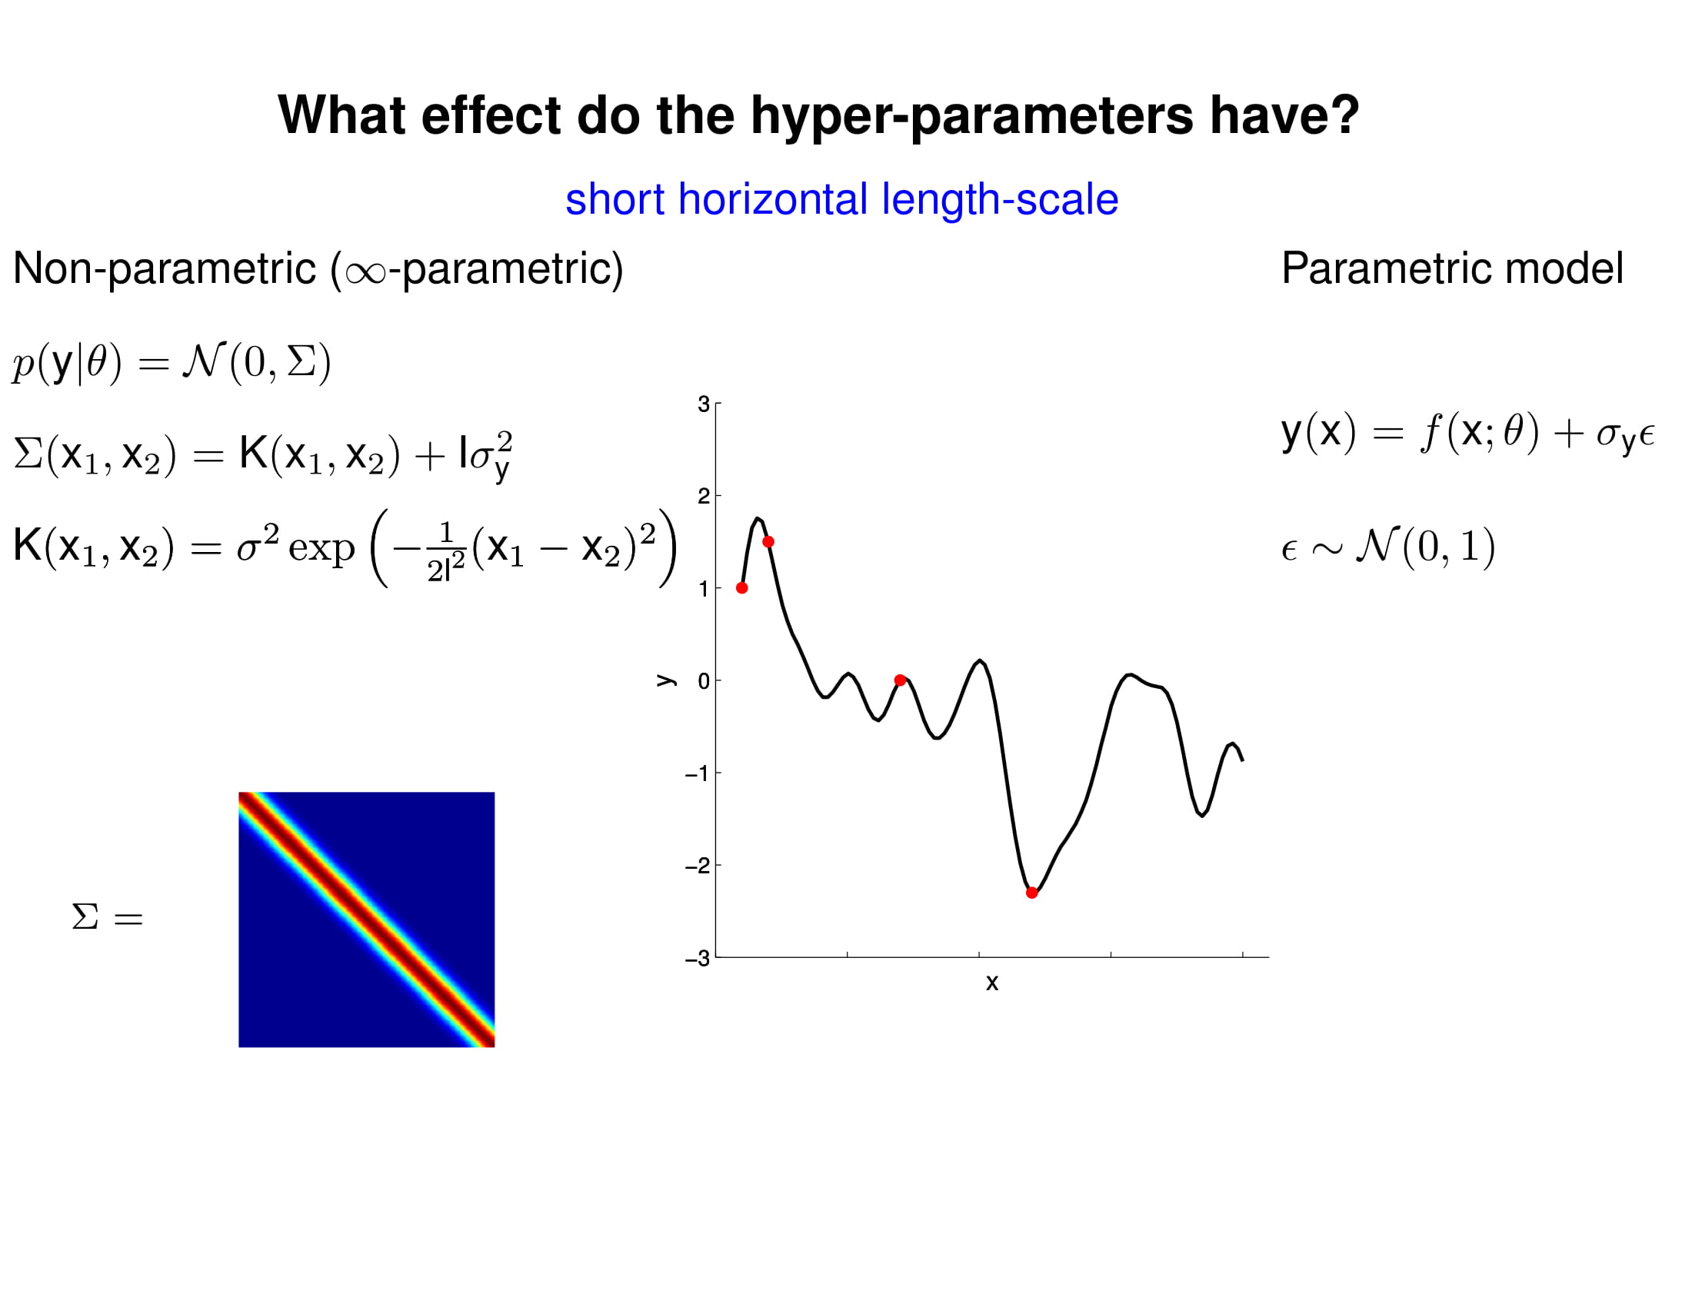

Slide 52
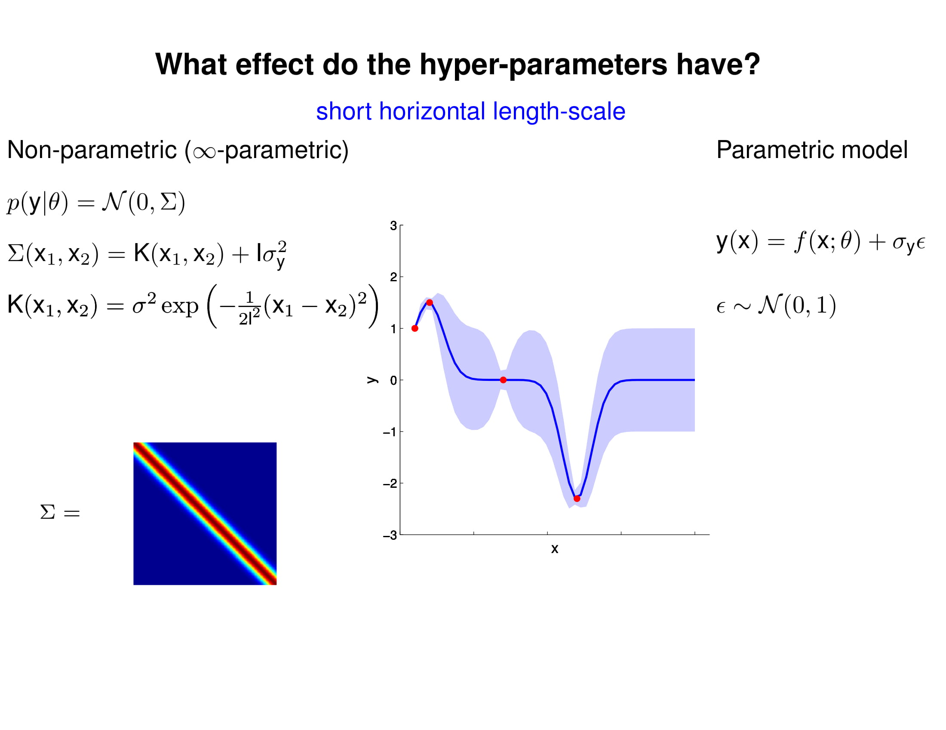

Slide 53
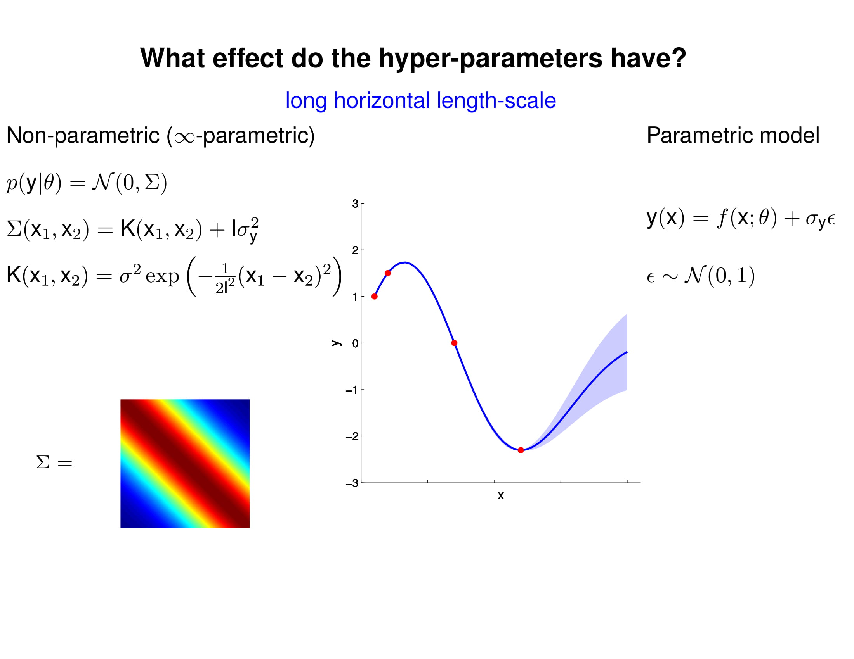

Slide 54
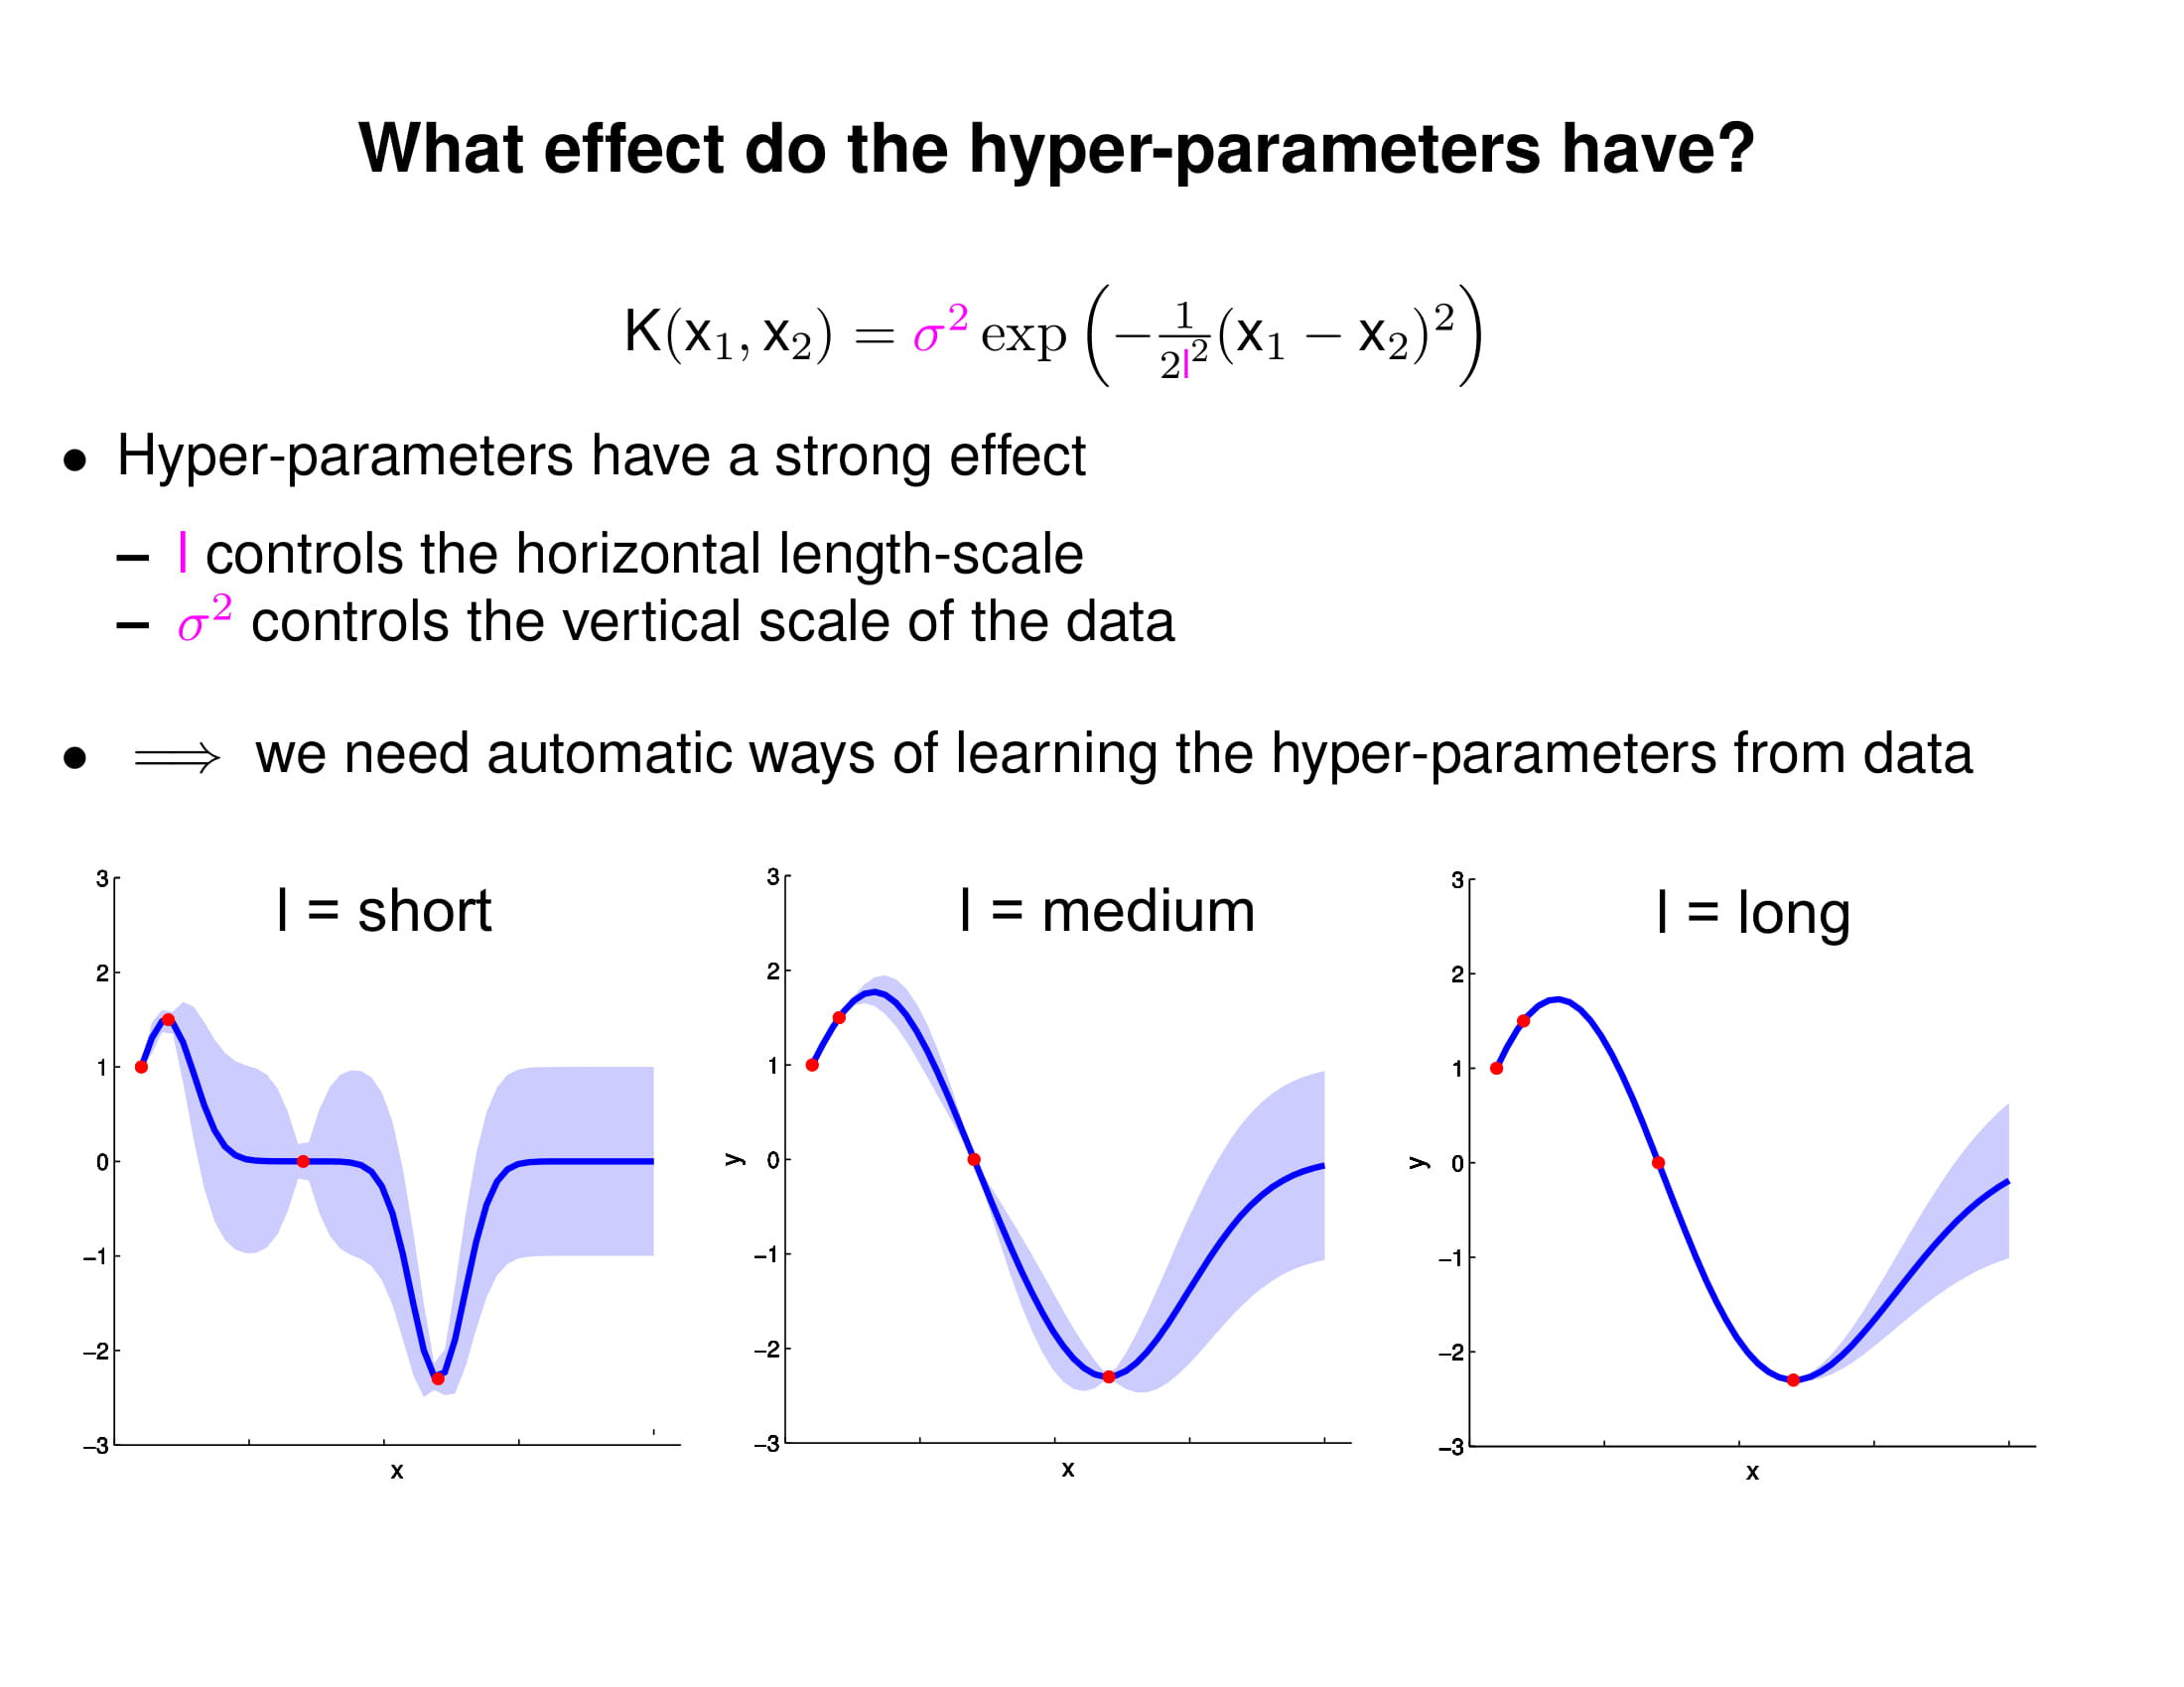

Slide 55
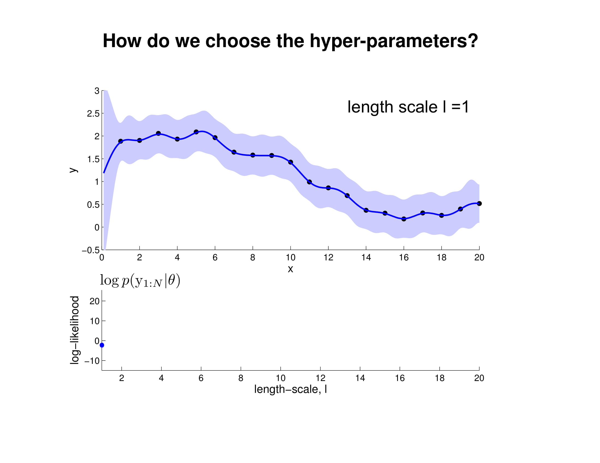
But Sam, we just prolonged our problem! We still have to tune the Gaussian Process hyper-parameters!

Slide 56
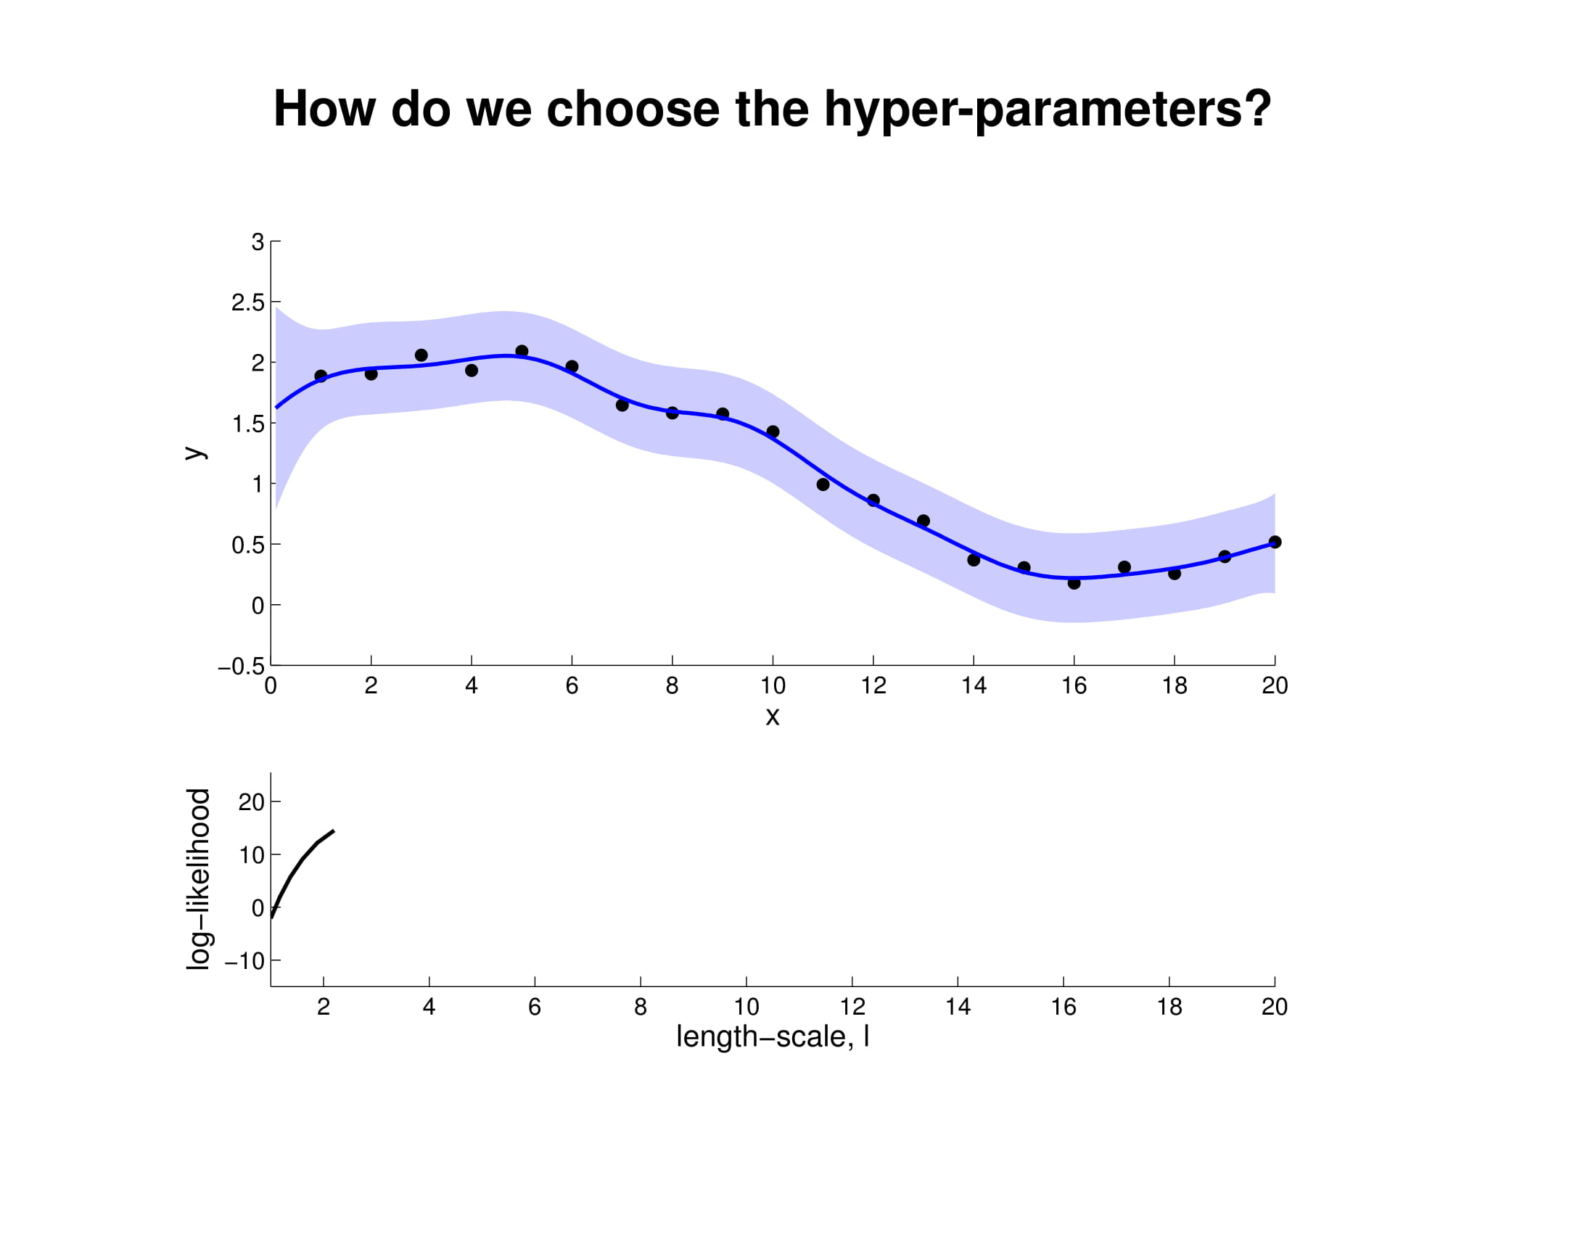
Gaussian Processes are usually less expensive to train, and can be optimized with Newton’s Method.

Slide 57
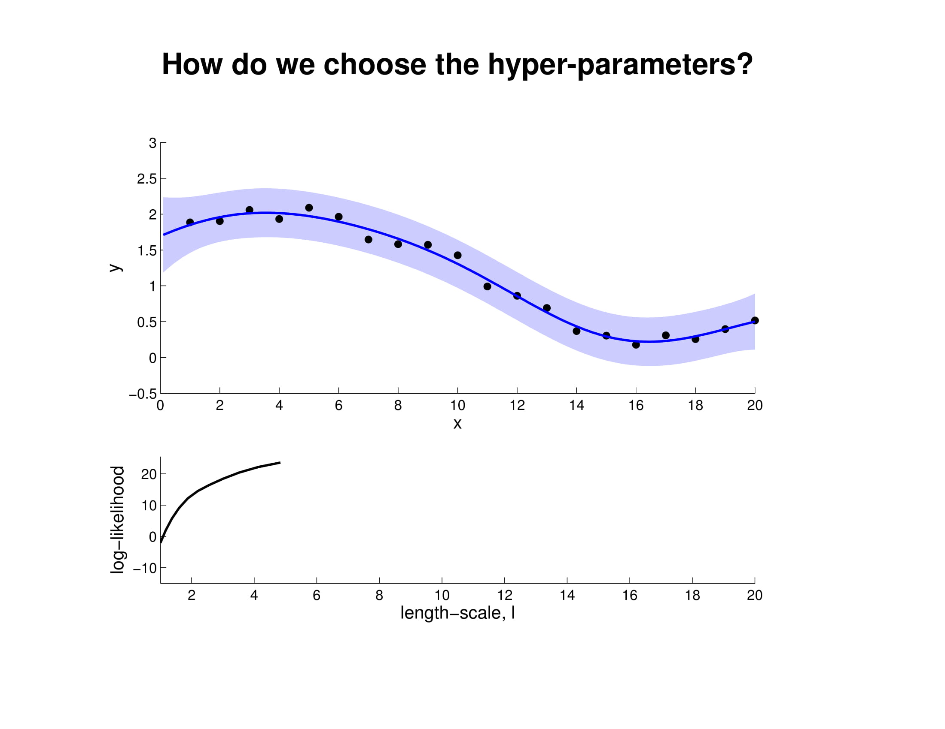
Gaussian Processes are usually less expensive to train, and can be optimized with Newton’s Method.

Slide 58
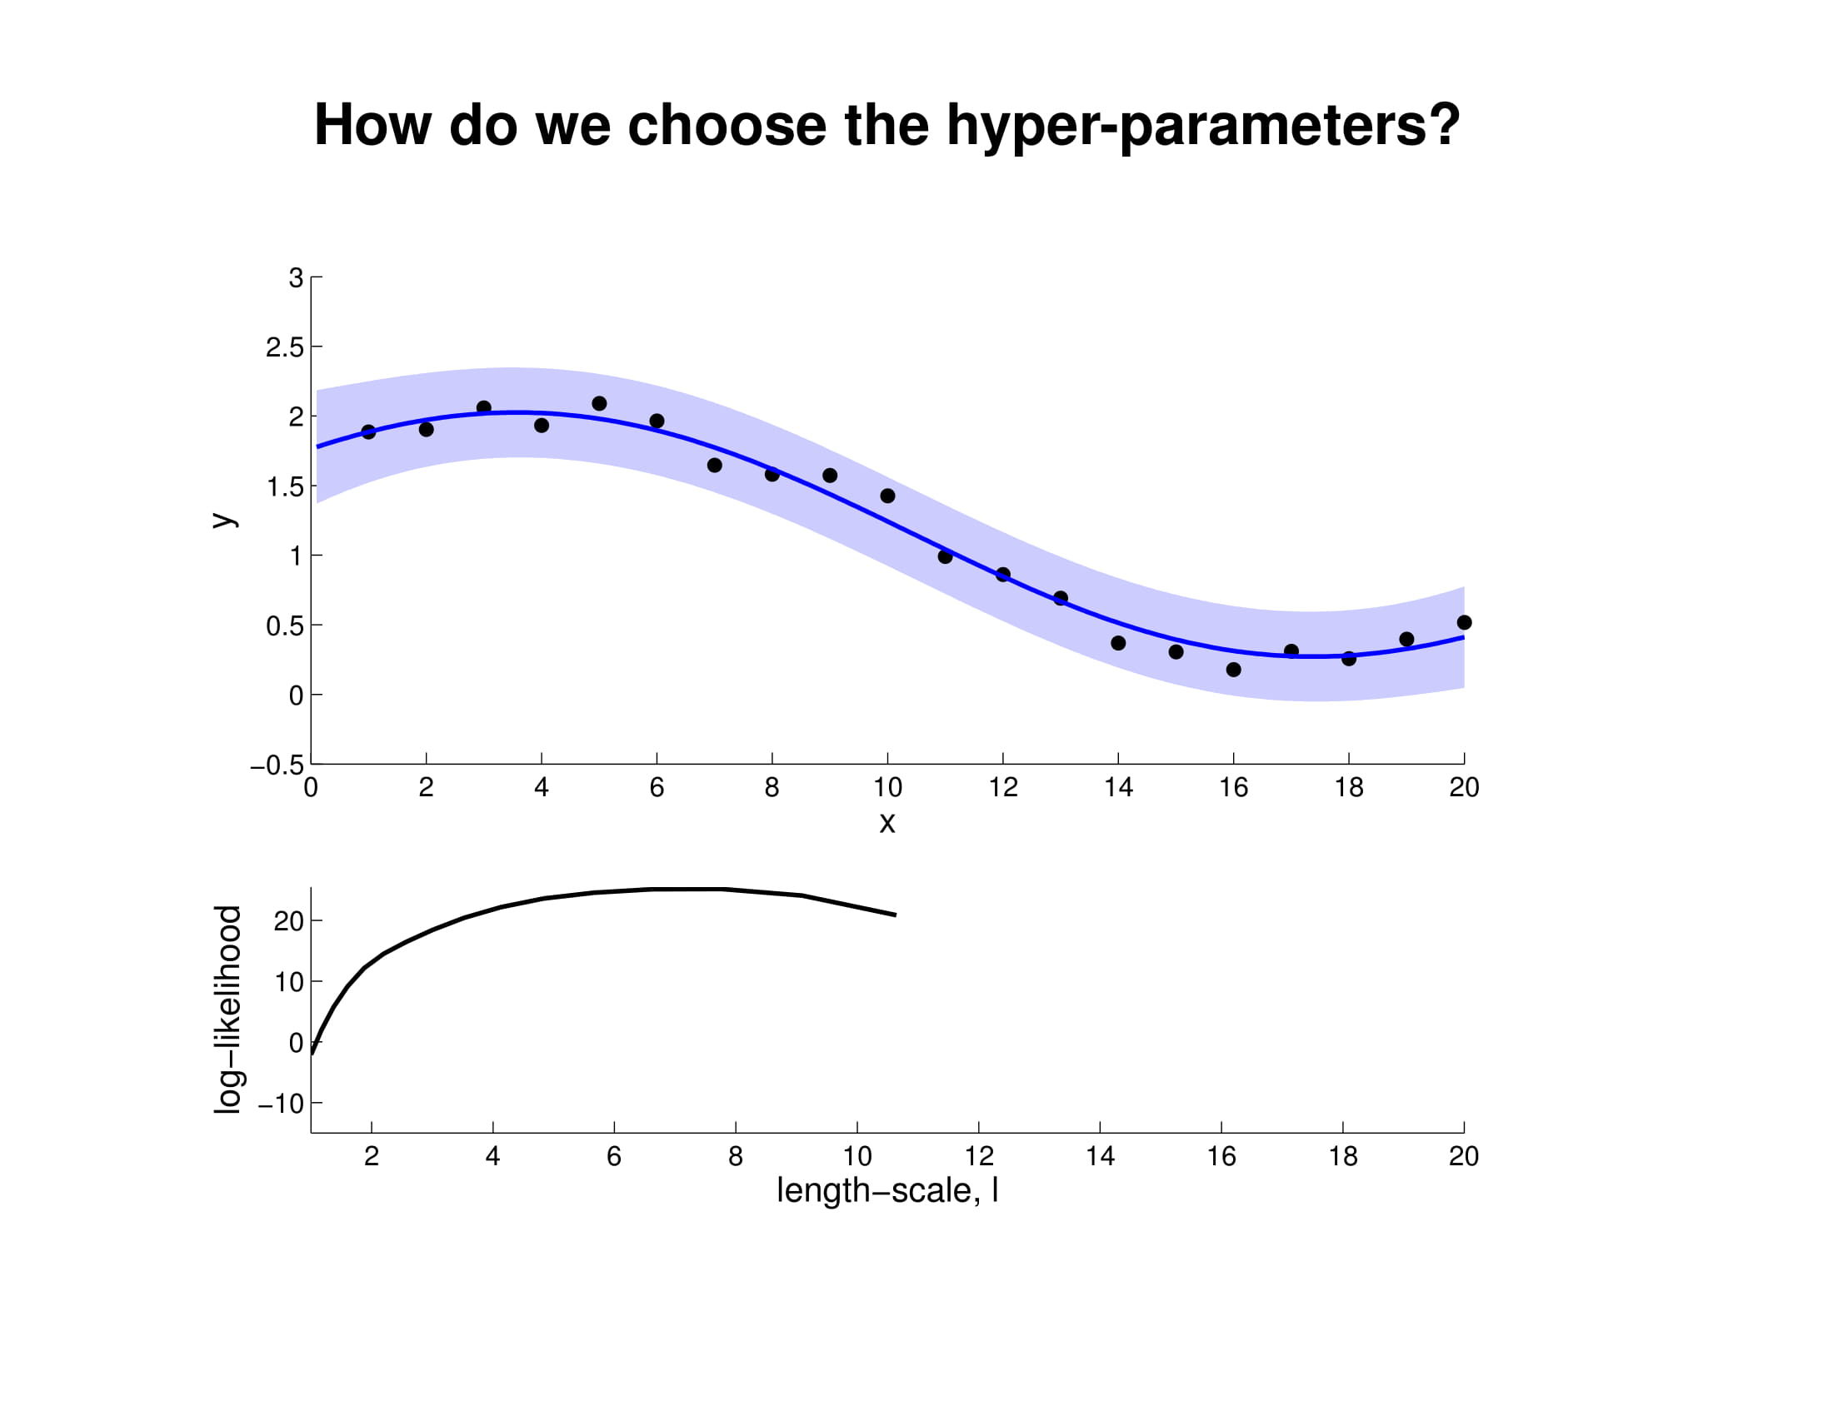
Gaussian Processes are usually less expensive to train, and can be optimized with Newton’s Method.

Slide 59
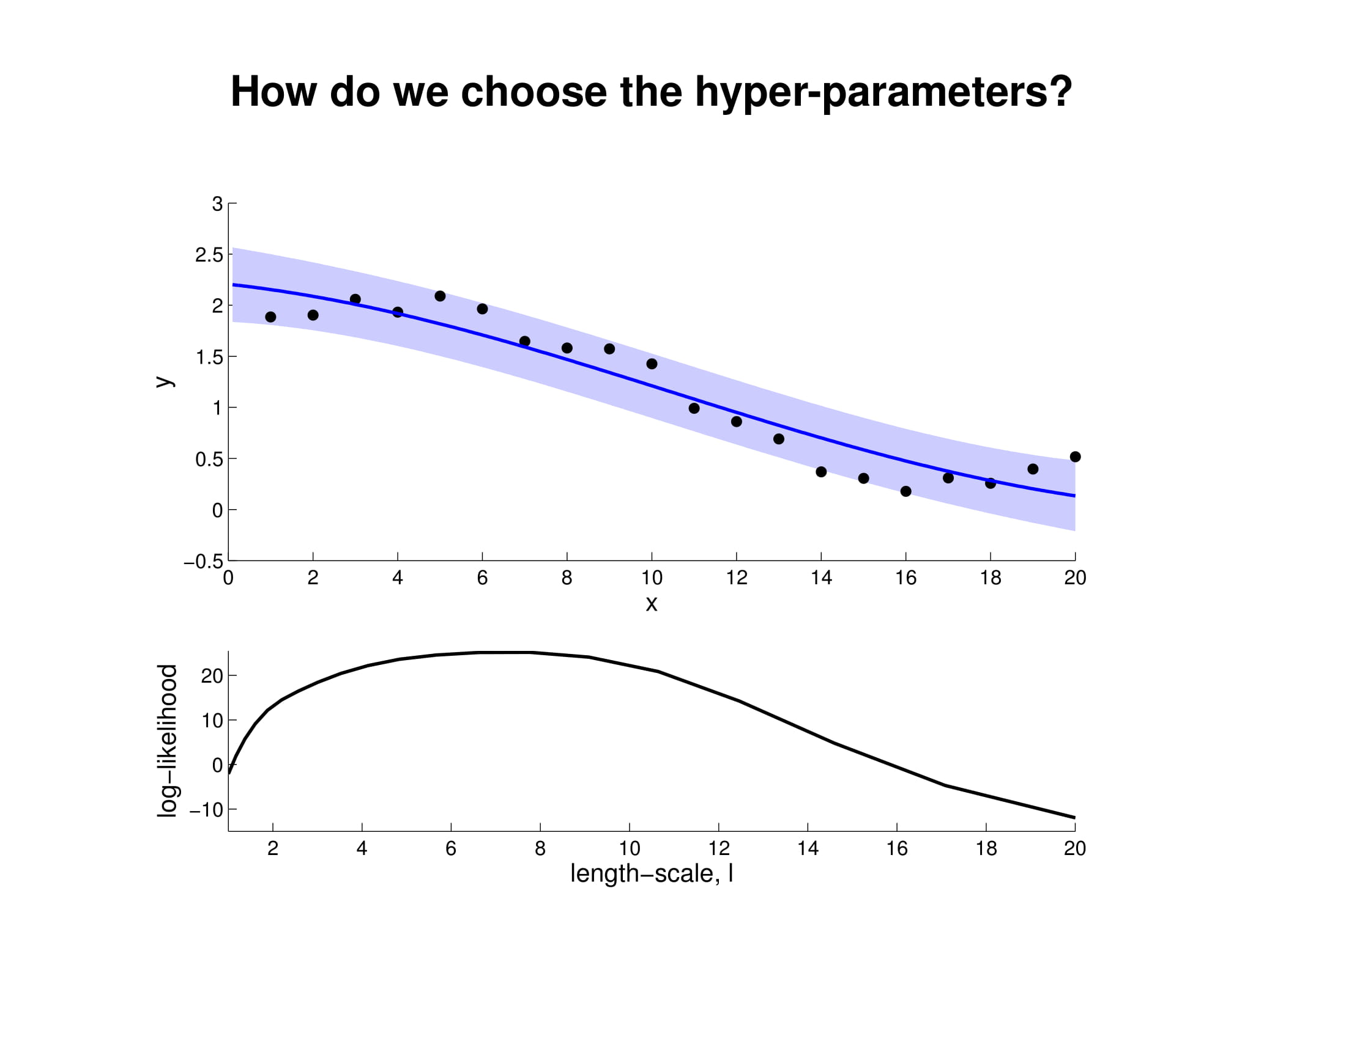
Gaussian Processes are usually less expensive to train, and can be optimized with Newton’s Method.

